Slide 1

Building Learning Power
Guy Claxton
4 Rs – the building blocks of learning
Notes:
If we take a view of the future – say 2030 – when the children we are all working with are adults and we are all in our dotage – what do we KNOW they will need to know?
The government thinks it knows: algebra, trigonometry, how to read, what an ox-bow lake is, how to do a titration (that’s chemistry), what the factors were in starting off World War One…
I’m not saying that some people won’t need to know some of these things at some time; or that having these bits of knowledge won’t make bits of their lives richer.
I’m asking, what we KNOW these children need to know in 2030.
Guy Claxton’s theory suggests that it none of these things. What children need to know is HOW TO LEARN STUFF.
His theory is called Building Learning Power. He believes that if children are nurtured in the building blocks of how to learn they will be able to access any learning they need for the rest of their lives.
We call it being a really Learny Learner. (As an aside Ken Robinson suggests that all children – 98% of under 5s in a study on divergent thinking – are GENIUSES at being learny learners and that the score drops dramatically over 10 years of schooling)
Claxton calls the building blocks of Learning Power the 4 Rs. They need to be nurtured in order as each is dependent on the last and at the same time they are all present in children.
We’re looking at the 1st R today and the other 3 tomorrow.
I love this!

Slide 2
With Forest School and BLP the focus moves from the ‘What’ of learning to the ‘how’, working to develop the child’s abilities firstly to cope and then succeed, rather than measuring the facts they can regurgitate.
“ To thrive in the 21st Century, it’s not enough to leave….with examination certificates. You have to have learnt how to be tenacious and resourceful, imaginative and logical, self-disciplined and self-aware, collaborative and inquisitive,” Claxton 2002.

Slide 3
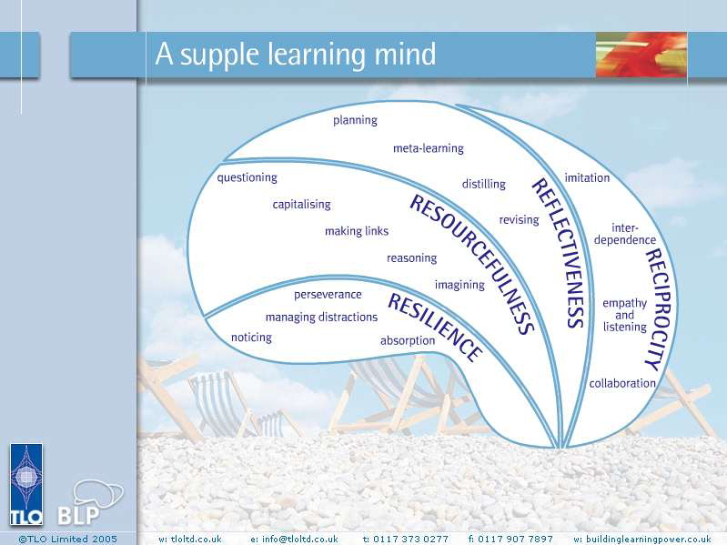

Slide 4
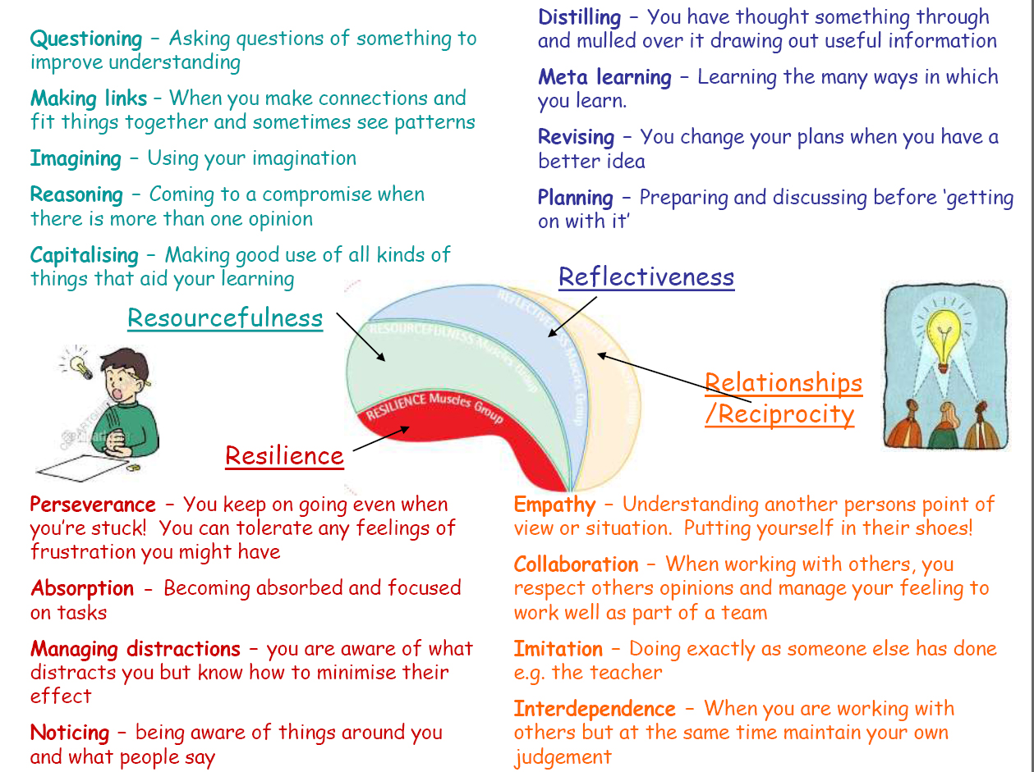

Slide 5

Emotional
(Resilience)
Cognitive
(Resourceful)
Social
(Relationships)
Strategic
(Reflective)
Notes:
Here’s the first one. It’s like a shiny light on the inside that makes you feel strong about yourself. It’s like a shiny like that gives you trust in yourself. It’s what Guy calls

Slide 6
R
esilience
Notes:
Resilience is the magic R – the one you need at the start of all learning
You need to have it…
in order to start learning
in order to articulate your learning
in order to make the mistakes that are essential for understanding
in order for your brain to be stress free and ready for learning
in order to understand that you need the learning that is on offer
resilience ivy – withstanding the knockback; enabling it to grow
What this looks like?
“It’s ok for me to have a go at this”
“I could try this”
“I wonder what would happen if…”
“I I think I know this – I’ll say”
“I don’t know”
“I can do this”

Slide 7
How do we know when children have good resilience?
Absorption - Flow, the pleasure of being rapt in learning
Managing distractions - Recognising and reducing interruptions
Noticing - Really sensing what is out there
Perseverance - ‘Stickability’; tolerating the feelings of learning

Slide 8
R
esourcefulness
Notes:
When children’s resilience is in place they are in a good position to develop…

Slide 9
Questioning - Getting below the surface; playing with situations
Making links - Seeking coherence, relevance and meaning
Imagining - Using the mind’s eye as a learning theatre
Reasoning - Thinking rigorously and methodically
Capitalising - Making good use or resources

Slide 10
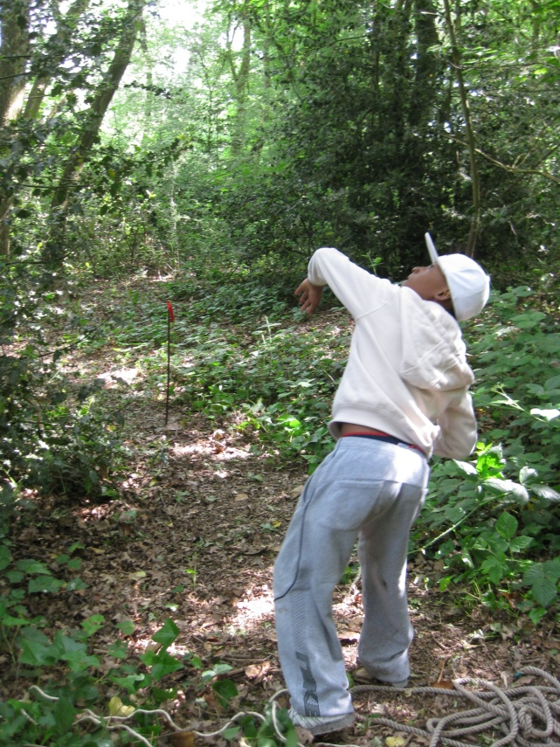
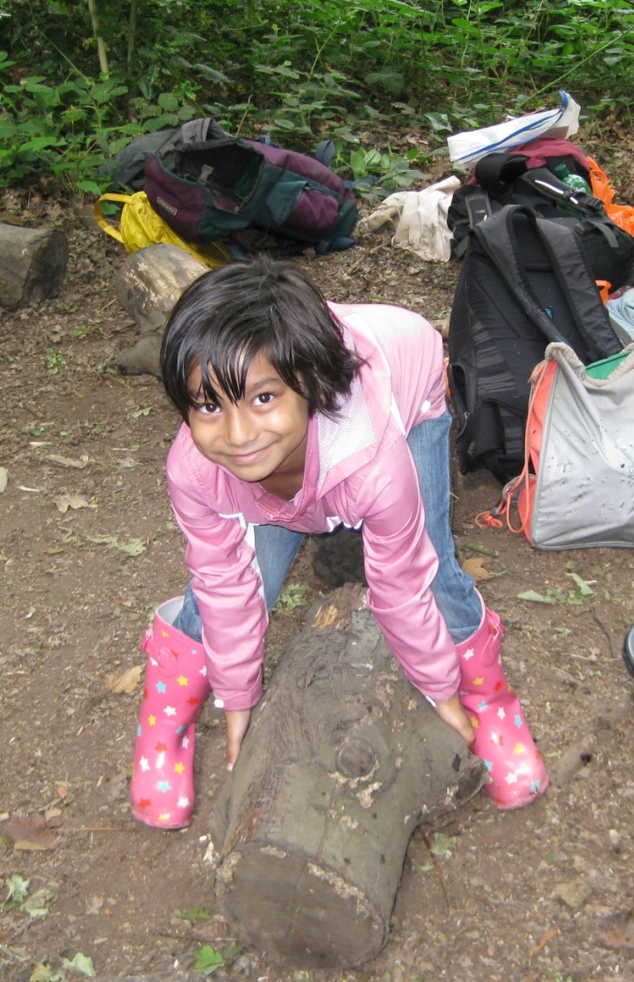
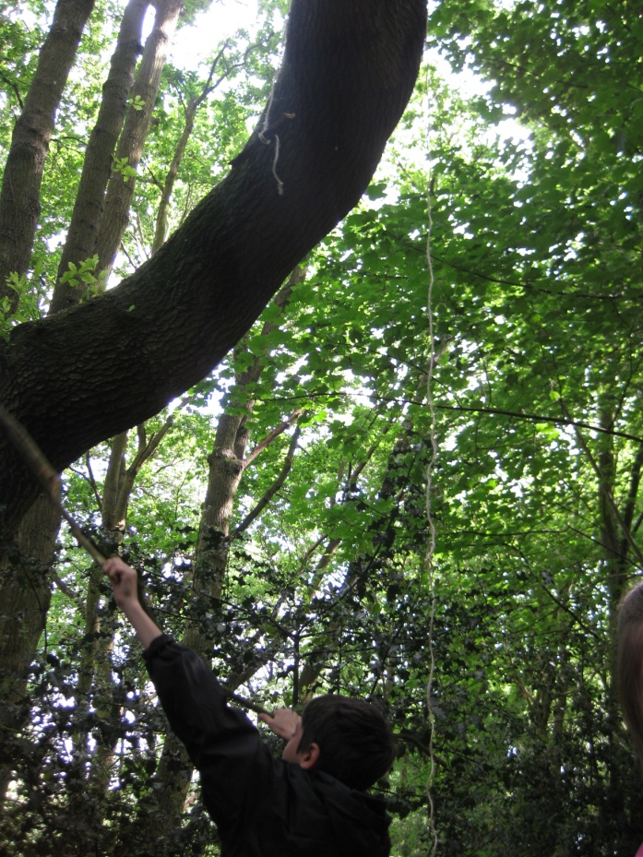
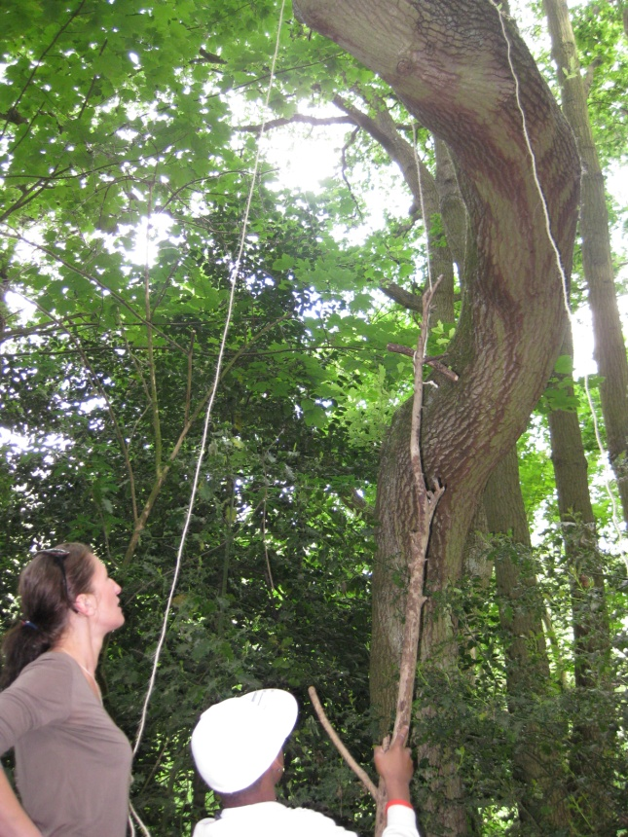

Slide 11
R
eflectiveness

Slide 12
Planning - Working out in advance
Revising - Monitoring and adapting along the way
Distilling - Drawing out the lessons from experience
Meta-learning - Understanding learning and yourself as a learner

Slide 13
R
eciprocity

Slide 14
Interdependence - Balancing self-reliance and sociability
Collaboration - The skills of learning with others
Empathy and listening - Getting inside others’ minds
Imitation - Picking up habits and values
Notes:
Reciprocity takes many many forms – and always means working with others – it is almost never silent! Have a look at these examples of reciprocity

Slide 15
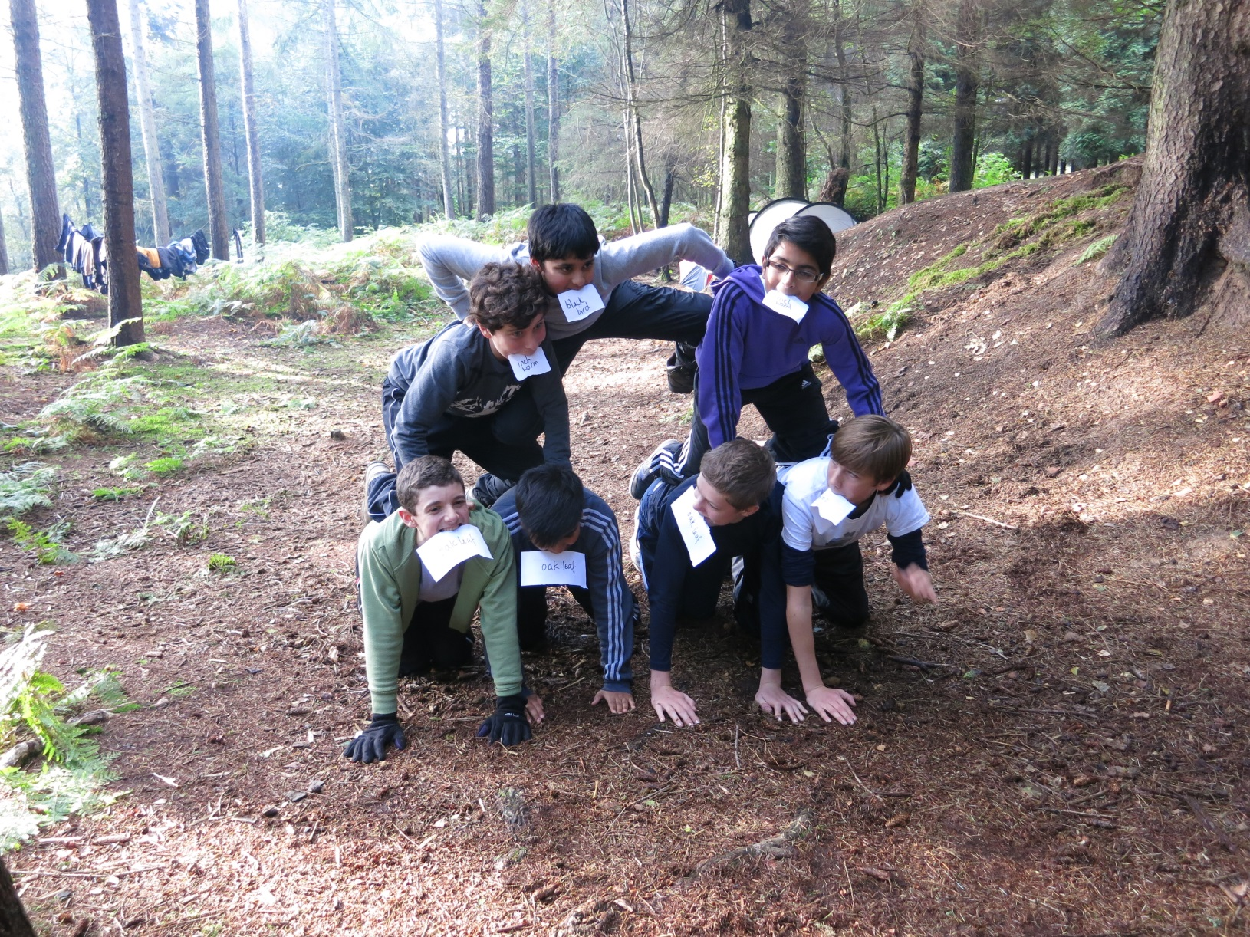

Slide 16
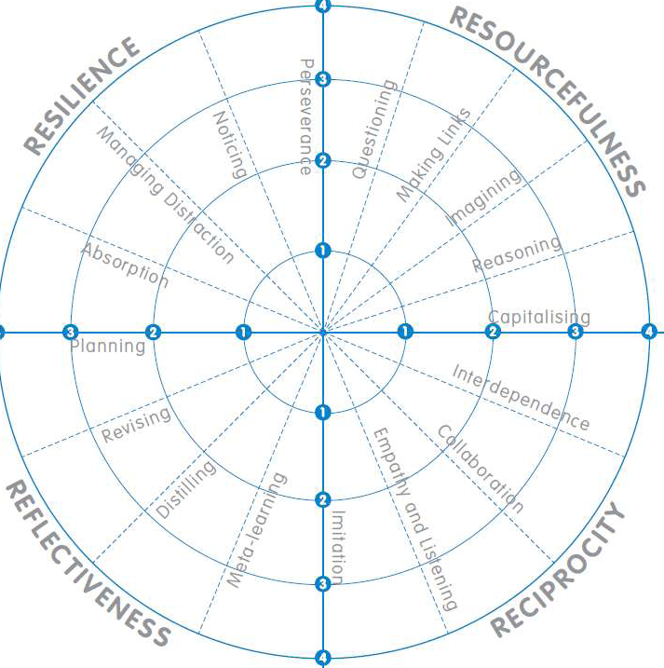

Slide 17
Making room for learning:
Changing Roles
‘The teacher's role shifts from being a
deliverer of material to a designer and
orchestrator of learning experiences.
The new role for teachers is more
creative and more engaging than the
earlier one.’

Slide 18
Focus on children & adult collaboration.
By collaborating, learners develop their
potential for learning. Specifically, learners
learn to approach and solve new problems…
rather than simply absorbing material, learning
rules, and displaying them on demand, learners
learn to develop capabilities in collaborative
learning situations that they use as a matter of
course elsewhere and at other times.

