Slide 1
Forest School July 2015
Rudolf Steiner (1861 – 1925)
Orla, Margaret and Hannah

Slide 2
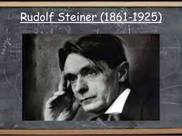
Rudolf Steiner
Was an Austrian philosopher, social reformer, architect, artist and scientist. He founded the first Steiner school in Stuttgart, Germany in 1919 after a request from the owner of the Waldorf-Astoria cigarette factory to open a school for the workers' children.

Slide 3
Key Features of Steiner Education
Steiner schools are always co-educational, take pupils from 3 -18 years.
They welcome children of all abilities from all faiths and backgrounds.
In the 80 years since it was developed Steiner education has become the largest independent educational movement worldwide.
The priority of the Steiner ethos is to provide an unhurried and creative learning environment where children can find the joy in learning and experience the richness of childhood rather than early specialisation or academic hot-housing.

Slide 4
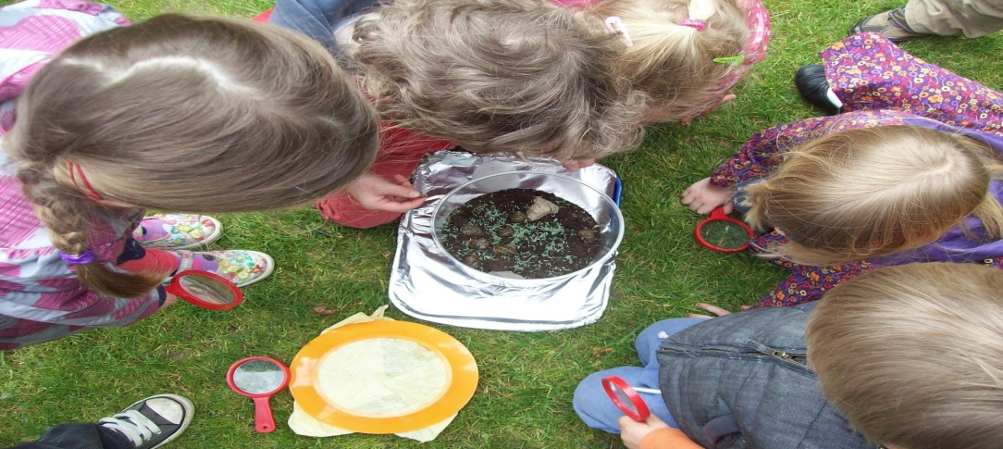
Aim of Steiner education
The aim of Steiner Waldorf education is to inspire in each student a lifelong love of learning and to enable them to fully develop their unique capacities.

Slide 5
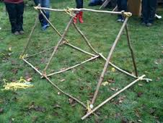
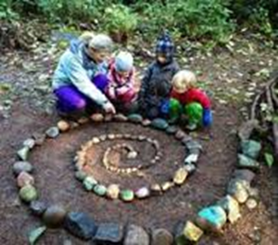
Key Features of Steiner Education
The linking of subject material and the integration of curriculum areas
The centrality of the relationship between the child and teacher in learning

Slide 6
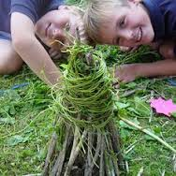
Key Features of Steiner Education
The quality of the relationship that the teacher establishes with the child is of central importance in the learning process.
Nurturing the child's sense of wonder and natural curiosity:

Slide 7
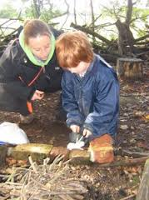
Key Features of Steiner Education
The child as an active agent in his or her learning.
Emphasis on the role of the parents as primary educators and the special relationship this builds with the parents and the school.

Slide 8
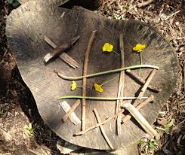
Steiner education
It gives equal attention to the physical, emotional, intellectual, cultural and spiritual needs of each pupil and is designed to work in harmony with the different phases of the child’s development.

Slide 9
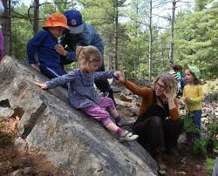
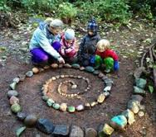
Steiner education
There is a strong emphasis on independent thinking, self-confidence, resourcefulness and creativity, along with small class sizes, a very positive peer group and inspiring teachers.

Slide 10

Rudolf Steiner (1861 – 1925)
“Our highest endeavour must be to develop free human beings who are able of themselves to impart purpose and direction to their lives. The need for imagination, a sense of truth, and a feeling of responsibility – these three forces are the very nerve of education”
Notes:
Confidence – this was developed by the children having the freedom, time and space to learn and demonstrate independence.

Slide 11
Steiner Ethos in Forest Schools
Steiner Ethos can be found very often in Forest Schooling.
Research undertaken by the UK Forestry Commission showed the impact of Forest Schooling on children, illustrating the similarities with Steiner Education.
http://www.forestry.gov.uk/pdf/SERG_Forest_School_research_summary.pdf/

Slide 12
Love of Learning
To nurture a child’s love of learning is the main priority of Steiner education.
Confidence – In forest schools children develop confidence in themselves by having the freedom, time and space to learn and demonstrate independence.
Motivation and concentration – the woodland tends to fascinate children and they develop a keenness to participate and the ability to concentrate over longer periods of time.

Slide 13


Slide 14
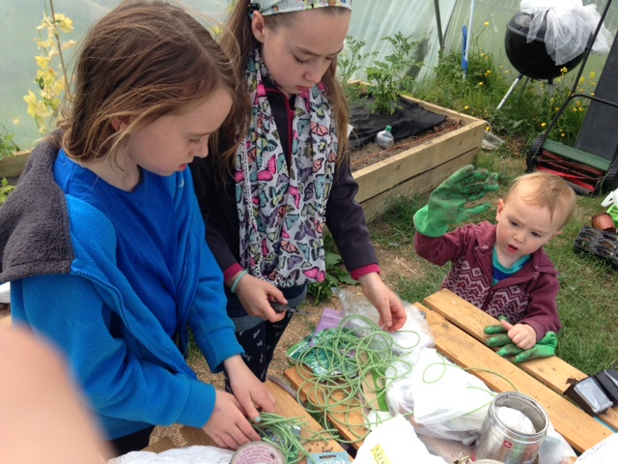
Knowledge & understanding
Forest schooling naturally encourages the children to develop an interest in the natural surroundings and respect for their environment. This is key to how Steiner wanted to develop the link between children, their spirituality and the natural world.

Slide 15
Physical Skills
Steiner encouraged self led play in an environment that enables risk taking and opportunities to develop perseverance. The Forestry Commission research showed that the improvement in children’s physical skills were characterised by the development of physical stamina and gross and fine motor skills.

Slide 16
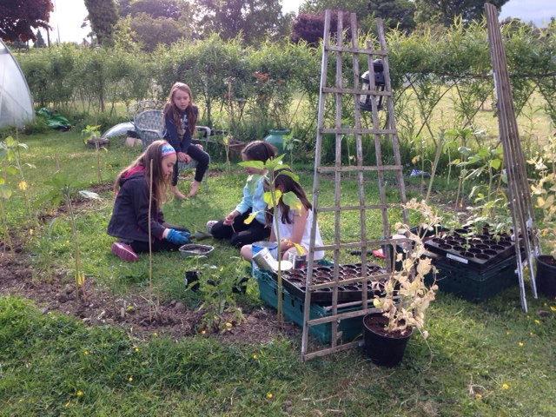

Slide 17
Social Skills
One of Steiner’s key features to have smaller ‘classrooms’, is also a feature in Forest schools allowing children to interact more closely with their peers, teachers and parents, giving them confidence in their curiosity and teaching them empathy. This was noted in the research.
Children gain increased awareness of the consequences of their actions on peers through team activities such as sharing tools and participating in play.
Language development is prompted by the children’s sensory experiences.

Slide 18
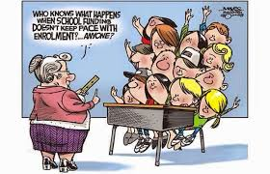

Slide 19
Educating the world
In Steiner’s “highest endeavour to develop free human beings who could impart purpose and direction” the research showed that:
The Forest School give teachers a new understanding of the children they teach as they observe them in a different setting.
Children take their experiences home and talk about them to friends and family, which sometimes lead to families visiting woodlands more frequently.
These knock on affects have a major impact on “the need for imagination, a sense of truth, and a feeling of responsibility – these three forces are the very nerve of education”

Slide 20
Relationships
Forest school provides a natural space for children and teachers using the Steiner ethos to develop a significant relationship through authentic experiences within the surroundings of the forest
Facilitating learning at the child's pace, quality of interactions between adult and child due to lower ratios necessitated in the forest.

Slide 21
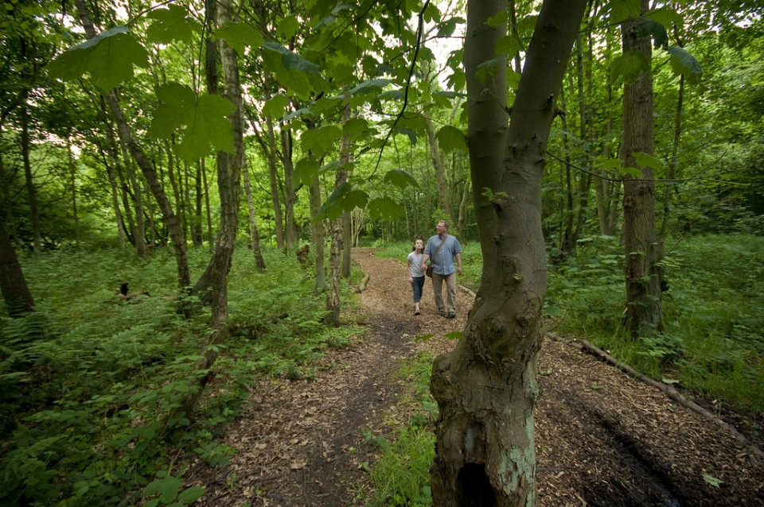
Establishing habits for a lifetime
Building lifelong love of learning - through the application of Rudolf Steiner's ethos within a forest school setting we are equally developing a life long love of nature and of the environment

Slide 22
Imagination, Truth & Responsibility in the Forest
Imagination - The natural environment – perfect canvas for imaginative play and learning, role play, and creation
Truth - An absence of ‘stuff’, authentic experiences, witnessing nature, cycle of life and death, regrowth through the seasons
Responsibility – Stewardship of the forest, ‘leave no trace’, managing the land

Slide 23


Slide 24
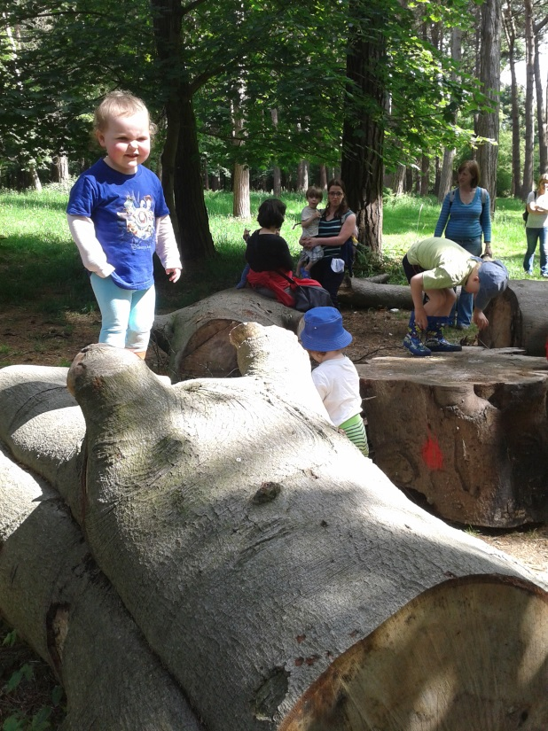
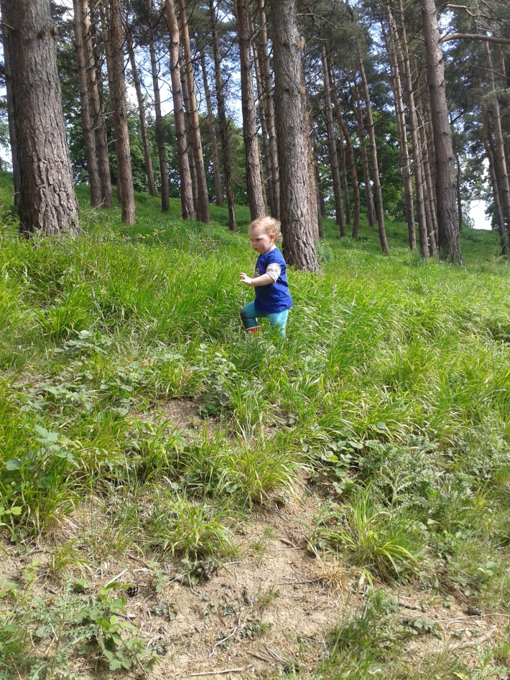
Child as capable and active learner
Developing in a holistic way
Construct their own knowledge through use of the senses, tactile experiences,
Kinaesthetic input – whole body learning

Slide 25
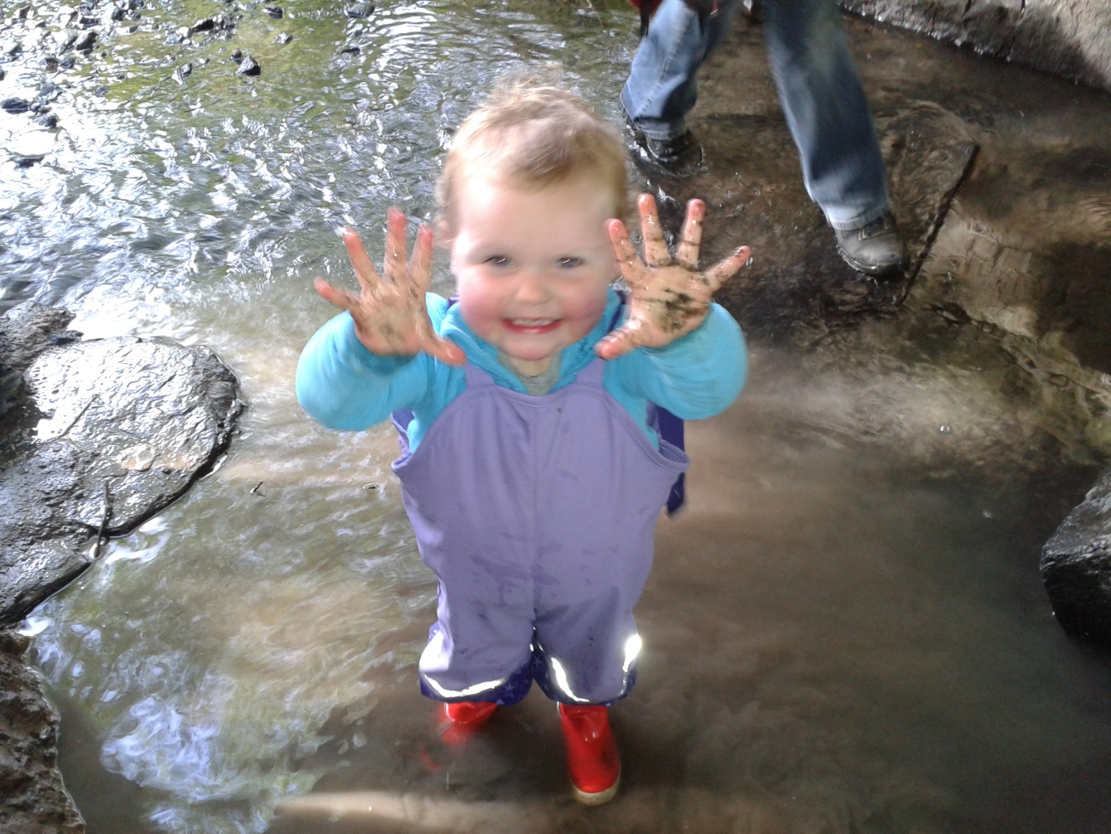
Thank You for listening! ☺

