Slide 1
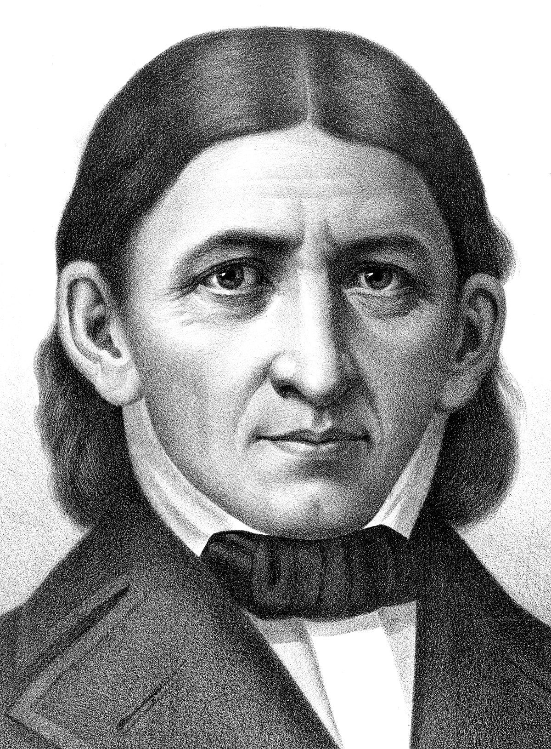
Friedrich Froebel (1782 – 1852)
Pestalozzi influence
Kindergarten (creative play, nature, movement)
Schools 1816, 1818
UK 1854
Ireland 1943

Slide 2
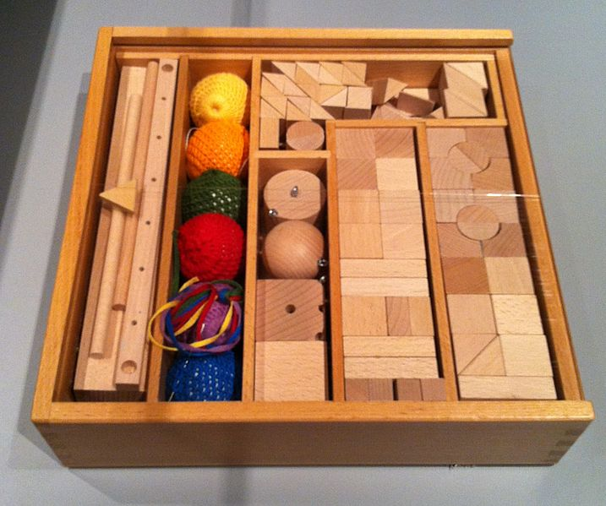
Philosophy
Play drives learning
Children can only learn what they are ready for
Unity
Teacher serves as guide
Classroom should be a prepared environment
Movement is imperative
Structured, graduated ‘Gifts’.

Slide 3

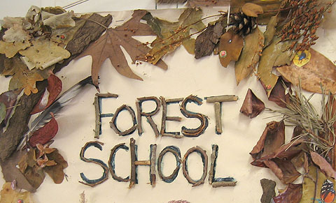
+
How the connection helps us understand and support development at FS?
P2: woodland or natural wooded environment.
Froebel: outdoor activity, connection with nature
P3: holistic development.
Froebel: Main goal of Froebel education is to teach whole child in all developmental areas such as socially, academically, emotionally, physically and spiritually.
P5: qualified practitioners.
Froebel: Froebel did not believe that nature was in itself enough; he strongly believed “the guiding hand of a trained, sympathetic and loving educator was essential to enable the child to make links and connections in their learning”.
P6: learner-centred processes.
Froebel: “Play is the highest expression of human development in childhood, for it alone is the free expression of what is in a child’s soul.”

