Slide 1
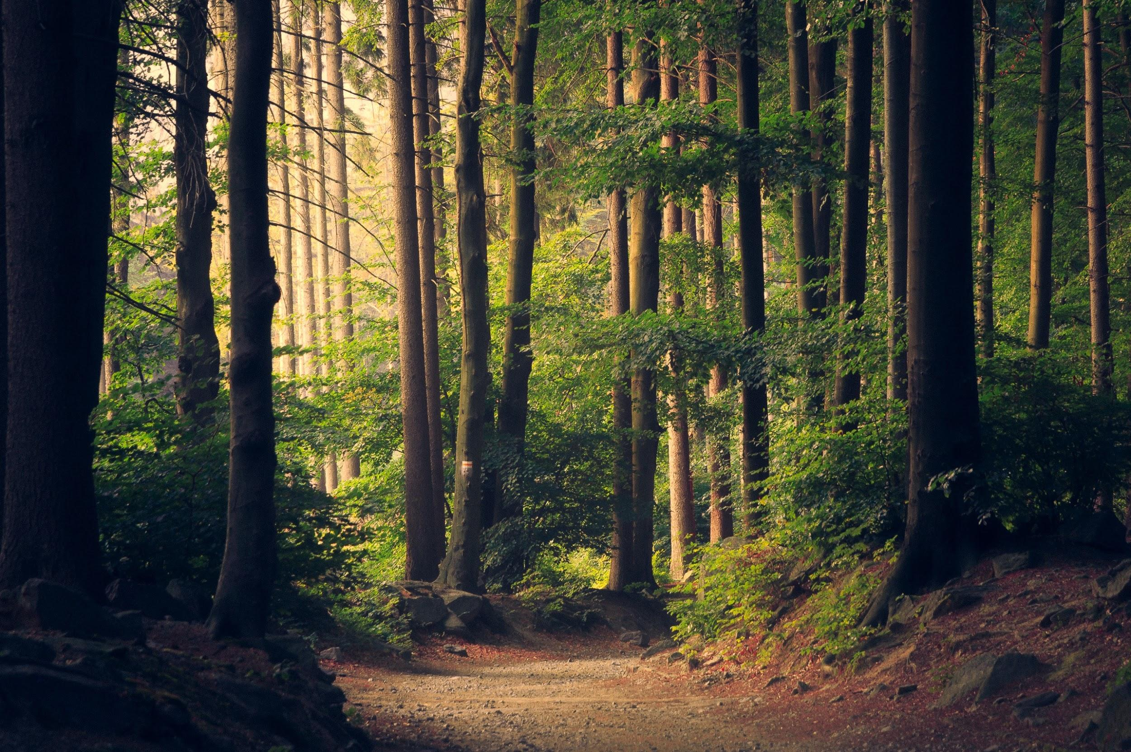
Montessori
and
Forest School Practice
‘Looking Through the lens of a forest school leader’
By
Barbara Sullivan & Barbara Gonzalez
Forest School Leadership Training 2017

Slide 2
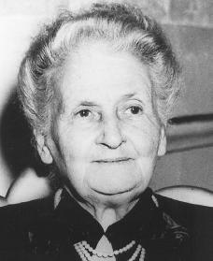
Maria Montessori (1870-1952)
Background:
First female doctor in Italy (1896).
Worked with and observed adults and children with additional needs.
Designed learning materials and a classroom environment to promote children’s desire to learn.
Opened first Montessori school for children in 1907 ‘casa de Bambini’.

Slide 3
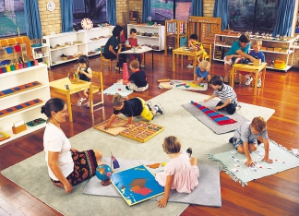
Montessori Principles
Prepared environment
Stimulating child centred, with freedom of movement and choice.
Active learning
Hands on experiences with self correcting materials designed by Montessori.
Active and holistic learning: children
recognise their own potentials and become
capable and cooperative.
Mixed age groups
Peer learning important
Children learn at their own pace.

Slide 4
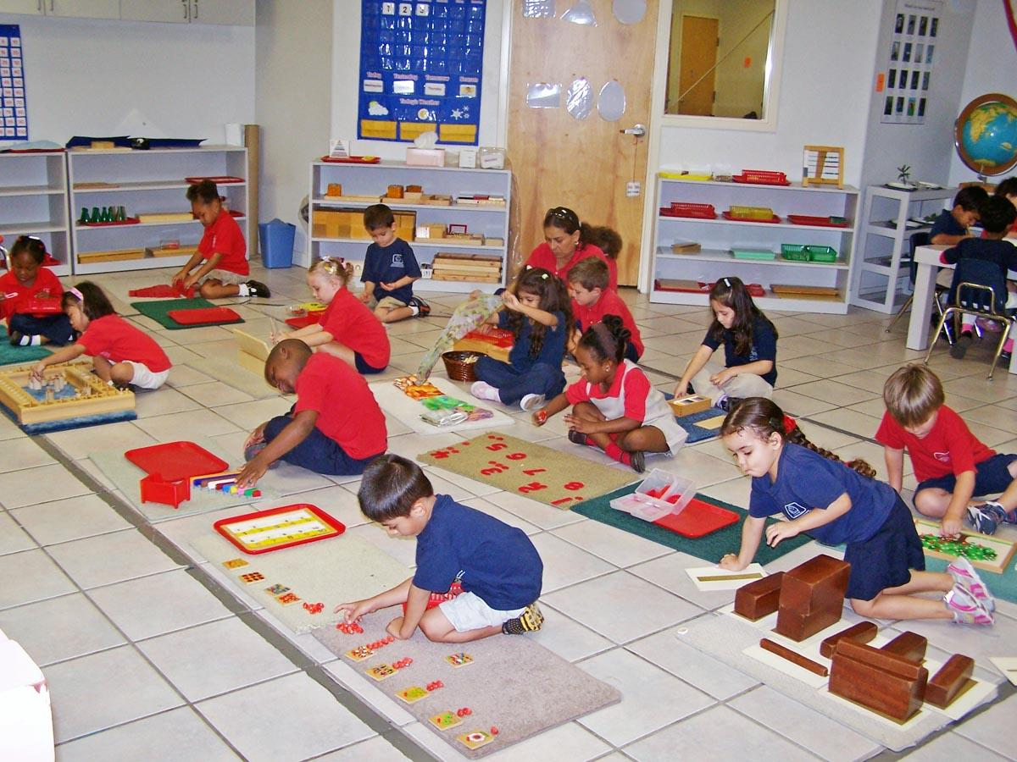
The role of the educator
Keeper of the environment: prepares learning materials.
Introduces children to new work materials.
Sits among the children, observes.
Act as a guide rather than teacher.
Play and discipline
Children should engage in meaningful, purposeful real life activities.
Believed that children develop inner discipline through taking control of their learning, through choices, clear rules and consequences.
Children become disruptive only if they’re bored

Slide 5
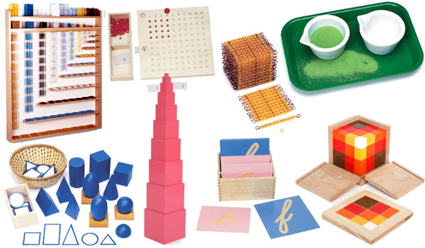
The Montessori Curriculum
The curriculum is divided into different areas:
Practical Life
Sensorial
Language
Maths
Cultural Arts

Slide 6
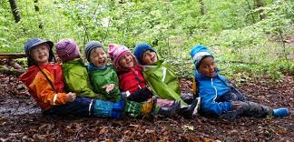
Forest Schools and Montessori-what is similar?
Principles
Child centred.
Observations.
Holistic development.
Focus on children’s choices.
Mixed-age groups, peer learning.
Children learn at their own pace
Practical life skills
Independence
Environment
Accessible, real materials which promote hands-on, experiential and discovery learning.
Freedom of choice and movement.

Slide 7
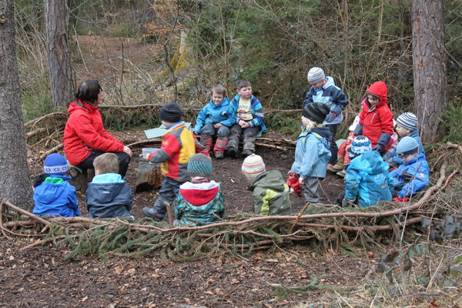
Routine
Structured: free movement, circle time, individual and group activities throughout the day.
FS: Clear beginning - middle - end.
Educator
Facilitator to support and scaffold children’s learning and development.
Presenting materials and modelling how to use them.
Promoting children’s independence within the environment.
Reflective educators.

Slide 8
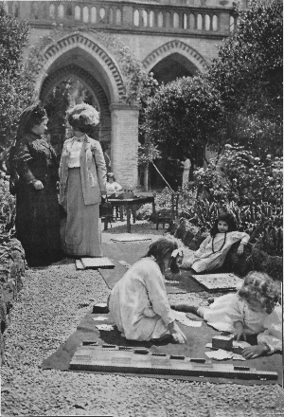
Forest Schools and Montessori-what is Different?
Forest School
Natural woodland environment
Risk taking
High adult child ratio
Family can take part
Appreciation of local environment
Montessori
Prepared environment
Self-correcting materials
Work presented rigidly, left-right
Concept of normalisation
Distinct curriculum areas

Slide 9
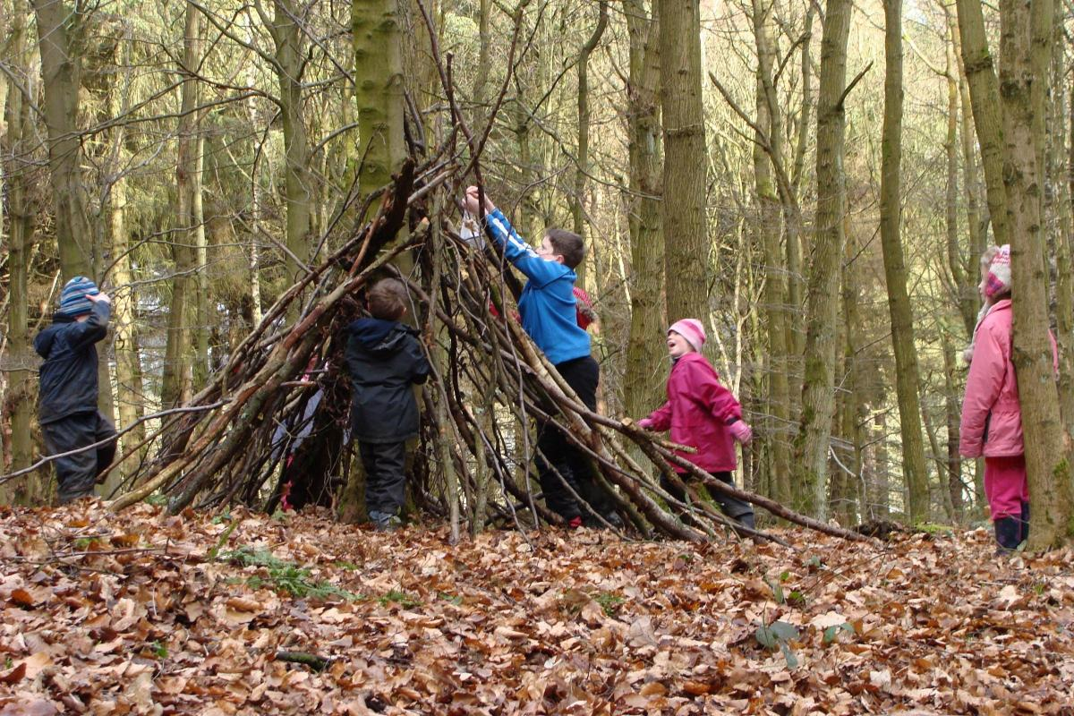
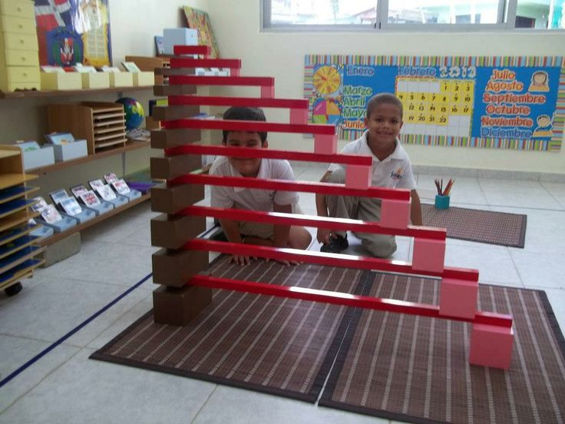
Despite differences in the building blocks for learning,
there is a lot of common ground
in the goals of Montessori and Forest School!

Slide 10
