Slide 1
Nature-centric models
Natural Cycles, flow and planning

Slide 2
Learning Outcomes
Unit 4
4. Be able to plan a Forest School programme in line with the Forest School ethos and principles.
4.1. Explain the role of the Forest School programme leader.
4.2. Explain the rationale of own Forest School programme showing links to own client group’s learning and development needs.
4.3. Plan the first session of an ‘Introduction to Forest School programme’.
Unit 5
Be able to facilitate an ‘Introduction to Forest School Programme’ according to the Forest School ethos and principles.
1.1. Facilitate an ‘Introduction to Forest School Programme’ with a minimum of six sessions, demonstrating flexibility in response to individuals’ needs.
2. Be able to assess the impact of the ‘Introduction to Forest School Programme’ on participants.
2.1.Observe a minimum of three participants assessing the impact of the ‘Introduction to Forest School Programme on each of the participant’s learning and development.
2.2. Make recommendations for progressing each individual’s learning and development as the programme continues.
3. Be able to evaluate an ‘Introduction to Forest School Programme’.
3.1. Evaluate each session of the ‘Introduction to Forest School Programme’ showing how observations and evaluations inform future session plans.
3.2. Carry out a summative evaluation at the end of the ‘Introduction to Forest School Programme’ explaining how this will inform your long-term Forest School strategy. Be able to evaluate an ‘Introduction to Forest School Programme’.

Slide 3
What do you already do when planning and evaluating?

Slide 4


Slide 5
What is a nature-centric model?
A model that is based on the natural cycles, and maps out a journey – gives us many viewpoints, feedback & different lens on reality & seeing patterns – as does an ecological system.
A model that helps us to connects us to the wider living system– the natural world.
A Culture: ‘the way we humans do things round here’ – how do our human systems reflects this wider connection with natural systems.
All older earth-based human communities linked human life and existence with the natural world around them.
Within education, we will draw on two nature-based models of planning and reflection with children, young people, or adults:
1. Joseph Cornell’s flow learning
2. Jon Young’s 8 directions model
3. Steve Van Matre – adapted activity audit

Slide 6
Cycle of a day
Midnight
N
Evening
NW
NE
Predawn
Sunset
W
E
Sunrise
SW
SE
Mid morning
Late afternoon
S
Noon

Slide 7
Cycle of a year – what does the season make you feel like?
Midnight
Winter
N
Predawn
Evening
Late autumn
NW
NE
Late winter
Autumn
W
E
Spring
Sunset
Sunrise
SW
SE
Late spring
Late summer
Mid morning
Late afternoon
S
Summer
Noon

Slide 8
Life cycle of a plant
Midnight
Winter
Seeds
N
Predawn
Late winter
Evening
Late Autumn
Decay
NW
NE
Germination
Sunset
Autumn
Fruiting
W
E
Sprouting
Sunrise
Spring
SW
SE
Rapid External Growth
Internal Growth
Mid morning
Late spring
Late afternoon
Late summer
S
Flowering
Noon
Summer

Slide 9
Human Life cycle
Midnight
Winter
Seeds
Elderhood
N
Predawn
Late winter
Germination
Evening
Late Autumn
Decay
Late Adulthood
NW
NE
Death/Conception
Sunset
Autumn
Fruiting
Adulthood
W
E
Birth
Sunrise
Spring
Sprouting
SW
SE
Childhood
Early Adulthood
Mid morning
Late spring
Rapid external growth
Late afternoon
Late summer
Internal Growth
S
Adolescence
Noon
Summer
Flowering

Slide 10
Joseph Cornell’s
The four stages of Flow Learning are:
1. Awaken Enthusiasm 2. Focus Attention
3. Experience Directly 4. Share Inspiration.
Joseph Cornell bases his teaching on five tenets that have helped him work with energetic, lively children:
teach less and share more
be receptive
focus the childrens’ attention without delay
look and experience first; talk later
ensure that a sense of joy permeates the experience.

Slide 11
What are the qualities of Joseph’s flow learning stages?
1. Purpose: Awaken Enthusiasm
Quality: Playfulness & Alertness
2. Purpose: Focus Attention
Quality: Receptivity
3. Direct Experience
Quality: Absorption
4. Share inspiration
Quality: Idealism

Slide 12
Jon Youngs Moods for flow learning cycle
– he added 8 stages to Joseph’s 4.
Integrate
N
Reflect
NW
NE
Open, listen to the moment
Inspire
Gather & share
W
E
SW
SE
Activate
Take a break
S
Focus

Slide 13
A session in nature
Distillation and Integration
Rest and restoration, answers/questions emerge
Decomposition
Release and Reflection
Contemplate, reflect, debrief
N
Open, listen
Soft beginnings
Warm welcome,
Gratitude, our senses,
whole body
NW
NE
Inspiration and Excitement
Refreshing ideas, Story on theme of day
Celebration and Harvest
Group poem, reflections, end ideas
W
E
SW
SE
Orientation and Motivation
Games, fun, Give crisp instructions and clear boundaries
Relaxation
Internalisation
Take a break,
Snack, water, sitspot
S
Focus
The ‘meat’ of the day – do the activity / task

Slide 14
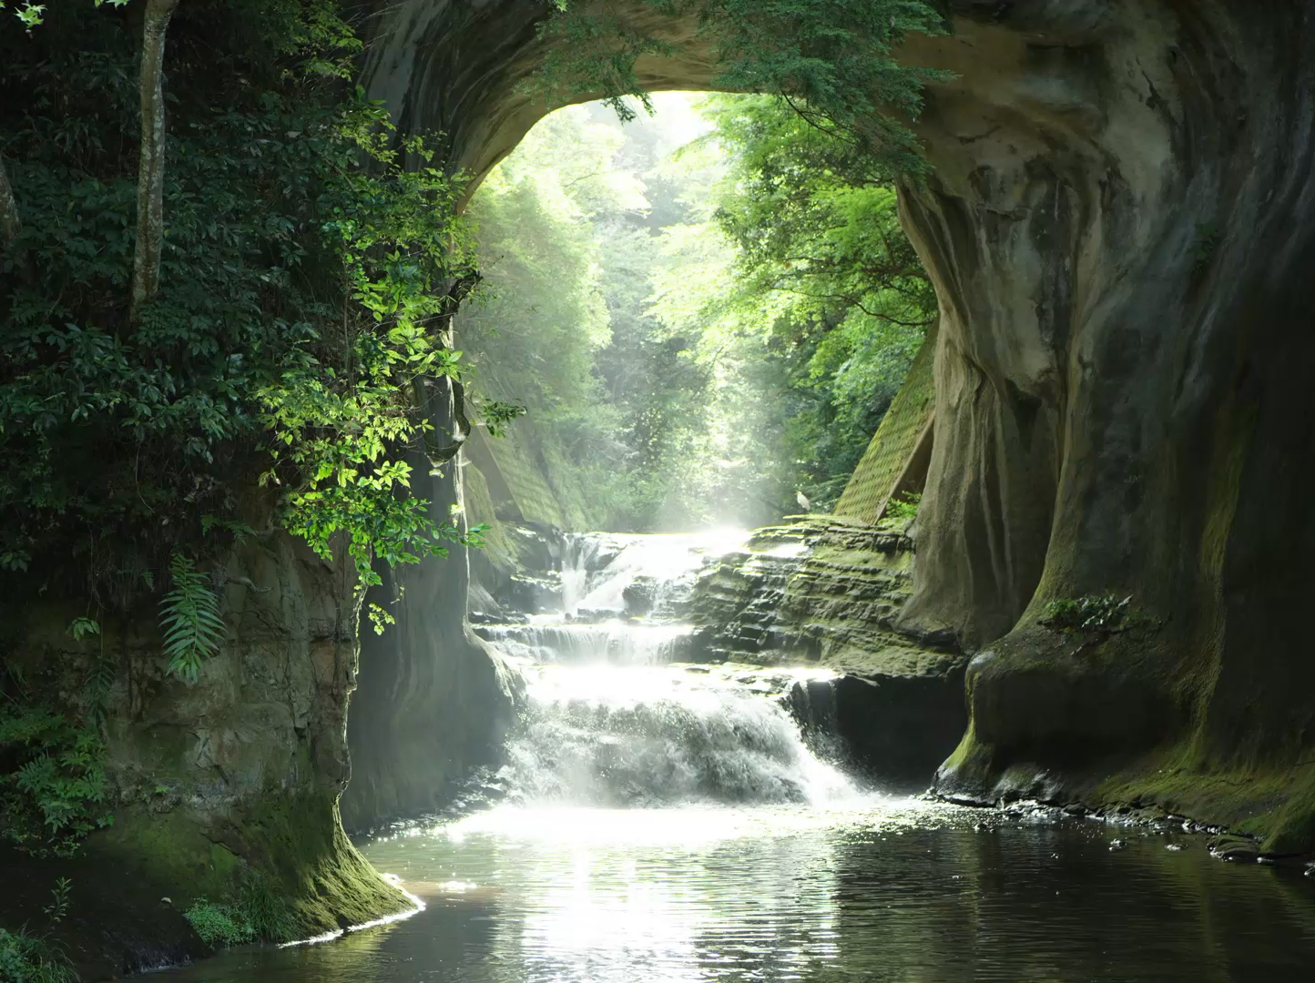
Planning for Forest School & Nature-based programmes

Slide 16

EXAMPLE TEMPLATE: Long term planning – example under 8 year olds
HALF TERM | Key Learning Objectives/intentions | Possible activities
Autumn 1 | Become familiar with staff, routines, safety rules of a forest school Explore a natural environment with senses Begin to work effectively as part of group | At school site: Exploring kit bag, practice getting dressed, collecting objects, simple crafts, exploratory objects, temporary shelters, games, songs & stories & games
Autumn 2 | Begin to be familiar with new environment via exploration Begin to be familiar with appropriate behaviour around a fire Make choices with growing independence | Exploring site, collecting objects, dragging rolling logs, using ropes, elder necklaces, charcoal drawing, fire making and cooking, mud faces, blob people
Spring 1 | Increase range of tools Initiate and pursue own interest Develop gross and fine motor skills | Revise safety routines, tool use (potato peelers, secateurs, loppers), cooking, knots, cutting and preparation for toasting sticks etc
Spring 2 | Increase range of tools As above | Revise safety routines, continue teaching skills (knife and saw), cooking, weaving, whittling & games, wild foods
Summer 1 | Solve problems Share and communicate ideas Celebrate personal & group achievements | Consolidation of skills and understanding, continue teaching skills where necessary. Introduce problems.
Summer 2

Slide 17
EXAMPLE TEMPLATE: Lesson pre-planning to include Aims, Learning Outcomes, Resources & risks
Group: | Staff: | Location:
Date: | Time: | Curriculum links:
Session number and Main activity (s):
Aims To develop knowledge of place To familiarise the young people with the site, establish a routine To encourage fun activity outside |  | Differentiation:
Learning Outcomes: The children become familiar with site and the adult The children will investigate the site with their senses sight, smell, touch and feelings
Key Language:
Resources: First Aid Kit, camera, tarpaulin and rope
Risk assessment reference: Site risk assessment, daily risk assessment and activity risk assessment

Slide 18
ACTIVITY & Season – E to W | SENSE | FEELING | MOVING/ STATIONARY | ENERGY
Travelling ideas | Sight, touch, smell, hearing, listening | e.g joy, kinship, awe |  | Low medium high
Gathering/starting (East Activities)
Singing/songs
Boundary ideas & Risk assessment
Fire making
Cooking
Crafting
Tools/woodwork
Swings
Games
Gathering/ending (West)
Earth Education: Steve Van Matre’s (1970’s) – Adapted Activity Audit

Slide 19
EXAMPLE TIMETABLE PLAN FOR A SESSION including Evaluation and Next steps
SESSION 1
TIME | ACTIVITY e.g shelter building, fire making | EVALUATION | Flow Learning/Jon Youngs 8 shields | NEXT STEPS/Future changes & ideas
9am 11.30am | Get ready to go – Get ready to go
Evaluation may include: practical evaluation on what went well or not so well; your own strengths & further support needed; in relation to flow learning or nature-centric models; in relation to young person’s self esteem, behaviour and learning; What changes in behaviour you may expect and were they achieved.

Slide 20
EXAMPLE TEMPLATE: Observations of individual pupils
Name of Pupil | General comments | Changes in self-esteem and self confidence | Changes in ability to work cooperatively and with awareness of others | Changes in levels of motivation and attitude towards learning | Demonstration of ownership and pride in the local environment | Demonstration of an improved relationship with, and understanding of the outdoors | Changes in levels of skills and knowledge (including key skills *)
Scoring notes: 1 = No change 2 = Slight change 3 = Dramatic change *Key skills: Speaking = S Listening = L Reading = R Writing = W Numeracy = N PSHE = Personal, social, development * Please include information from Nature Centric cycle if appropriate

Slide 21
References
Jon Young, Ellen Haas and Evan McGown (2008) Coyote’s Guide to Connecting with Nature. Owlink Media. Washington
Cornell, J. B. (1979) Sharing Nature with Children, Exley Publications, U.K.
Cornell, J. B. (1989) Sharing the Joy of Nature, Dawn Publications, California USA

