Slide 1
Our brain
Understanding the basics of neuroscience
The importance of neuron survival
Being hard-wired for survival – meeting reptiles in the Forest!
Stress and relationships
Secure attachments

Slide 2
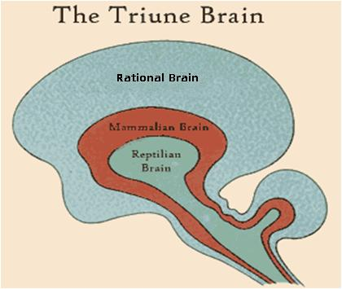
The Triune Brain
The reptilian brain
- lower brain/brain stem
The mammalian brain
- mid brain/limbic system
The rational brain
- higher brain/neo cortex

Slide 3
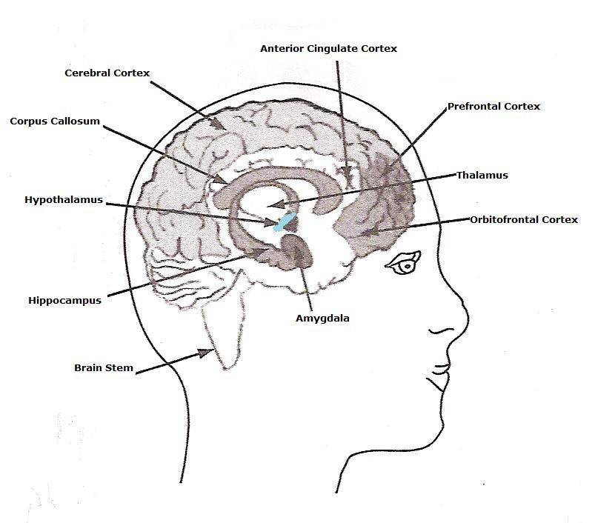
Reptilian: The oldest brain structures are the brainstem and cerebellum – that control our body’s vital functions of heart rate and breathing.
Mammalian brain: The limbic brain, consisting of the hippocampus, amygdala and hypothalamus, is responsible for emotions, values and other unique functions that control so much of our human behaviour.
The Rational brain: Is responsible for language, cognition, executive function, consciousness – in other words higher other thinking and imagination that influence individual learning and the development of culture and society more broadly.

Slide 4

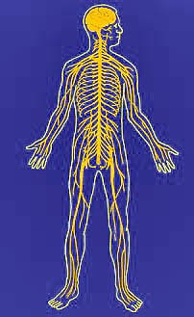
The brain serves 2 functions:
First it controls all neurological (body nervous system) and physical functions – it keeps us physically alive.
Second it is a learning tool with a capacity in fact an inbuilt drive to grow.

Slide 5
The Basic Constituents
Basic building blocks of the brain – nerve cells or ‘neurons’ – information processing cells.
Dense network of neurons, each one a mini eco-system taking in nutrients, generating energy, and adapting to environmental
changes.
Our brains:
Use up to 20% of the body’s oxygen supply
And an incredible 60% of the body’s glucose supply
Billions of neurons make up the nervous system. (100 billion – like trees in the Amazon)
They maintain us as fully functioning human beings
Everything you see, feel, think, and do is dependent on their
ability to communicate with each other – making connections (60 trillion connections in the adult brain – like the leaves on the trees in the Amazon).

Slide 6
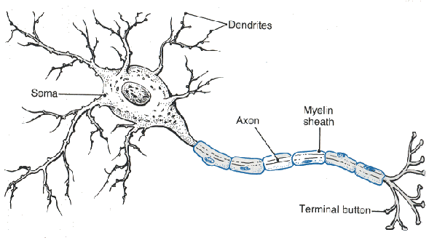
Neurons – the raw materials
Neurons are by nature social entities and actively search out other neurons that connect together to produce neural networks
Each neuron’s centre can carry an electrical impulse
Important features:
Dendrites
- receive messages from other neurons
Axons
- transmit messages to neighbouring cells
Axons are covered in white myelin – a protective sheath that acts as an insulator, enhancing the axon’s firing efficiency
The thicker the myelin surrounding the axons, the speed of action potential is increased, and the regeneration of axons. As cells are used, the myelin sheath is strengthened.

Slide 7
Babies are born with twice as many neurons and connections than adults! Connection production!
The neurons are there ready to be sculpted, some are strengthened and some are pruned. If you don’t use it, you may loose it!
Neurons survive when they send and receive information, when they make successful connections – if not they die.
Learning is about creating and strengthening pathways through these neurons for impulses of electricity to pass along. To learn something new the impulses need to jump across the gap (synapses!).
Balance is the first sensory system to develop – myelinised by time of birth. Myelin is an electrically insulating material surrounding the axon of a neuron. Without it, you couldn’t sit, crawl or stand, BUT a child needs years to learn how to use this system efficiently.

Slide 8
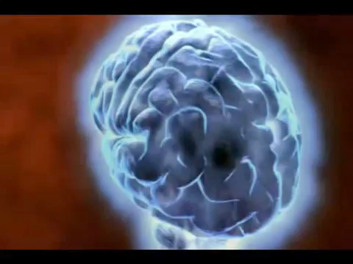

Slide 9
The Reptilian Brain......
Connects to the spinal cord and thereby to the whole body
- Central Nervous system
A major component of the Central Nervous system is:
Autonomic Nervous System: Regulates bodily functions that occur beneath the level of conscious awareness e.g. heart and respiration rates and blood pressure
Sympathetic Nervous System
- Stimulates functions associated with the stress response
Parasympathetic Nervous System
- Stimulates the relaxation response in the body

Slide 10


The Reptilian Brain..and children
Deepest most ancient part of the human brain, largely unchanged by evolution - shared with all other vertebrates
Responsible for instinctive behaviour related to survival (fight flight freeze and territorial instincts)
At birth we are ‘hard-wired’ for survival.
Our brains instinctively respond to threat and produce the response of flight freeze fight.

Slide 11

We all have an instinctive response to fearful and stress inducing experiences …. We
RUN
FIGHT/ATTACK
HIDE/WITHDRAW

Slide 12
Remember….
When a child feels threatened or angry the reptilian brain takes over control from the cortex (rational brain)
IQ plummets...appeals to reason just don’t work
The child has to be calmed first. The use of play is better than a cognitive approach in these situations
The reptilian brain returns the body to homeostasis:
a securely attached child is both CALM and ALERT.

Slide 13
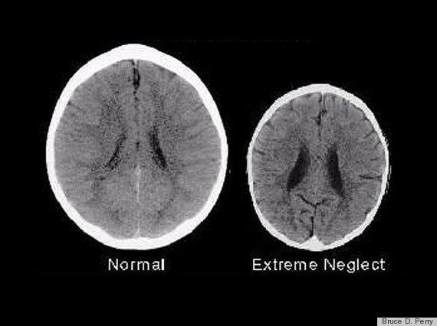
In the first 18 months – the learning is needed to establish neural connections concerned with relationships and the emotional ‘tag’ to those relationships.
Baby brain is an emotional organ … it functions through relationship and learning is based on relationship.
For first 18 months of life brain learning is based on relationship.
  Underdeveloped or shrunken brains are due to poor relational experiences, and relational stress – so children don’t have the capacity to be socially appropriate, empathetic, self – regulating and humane.

Slide 14

Summary: In order to help us deal more rationally with fearful or stress-inducing experience we need to be helped from birth to switch on our higher thinking brains on:
Higher brain
Rational processing
Logic, moral judgement
Imagination, language
creativity
MID –BRAIN:
Emotional response to experiences- hard-wired for
Empathy/relationship
memory
Lower brain-reptilian
flight freeze fight

Slide 15
Further to John Bowlby’s research (founder of child development theory of Attachment in 1950’s – 1980’s) current neuroscience and the results of brain scans shows that the part of the human brain switched on at birth is similar to all other mammals.
We all need to experience in our first year of life:
Holding
Mirroring
Reflecting
Feeding
Mutual cueing
These are the basic needs which if met in the early years will establish a sense of well being that you are safe and your presence is welcomed
IT IS ONLY WHEN WE HAVE ESTABLISHED A SENSE OF SECURITY THAT WE CAN BEGIN TO DEVELOP OUT FRONTAL CORTEX- THE HIGHER THINKING CAPACITY UNIQUE TO HUMANS

Slide 16
How do we do this?
Secure attachment: relationship that is internalised that informs a person’s internal working model of self, other and feelings of being in the world.
Neuroscience of attachment: Attachment is a huge hormonal force that deeply affects the brain, mind, physiology and even how we lay calcium in the bones (Dr Margot Sunderland)
If the baby experiences consistent holding mirroring reflecting and feeding for at least the first 8-12 months of life. He/she will have foundations laid of feeling safe, a sense of belonging, optimistic outlook on life, my needs are met and will be met. Under 4’s have a need every 20 seconds (Lieberman, A 1995).
Examples: To sooth, to show you something, to say ‘wow’, to cuddle, to help her switch tap on, to get you to be delighted, to listen to her story.
  Under stress: Brain scans of impulsive murderers – show poor impulse control in the frontal lobes similar to that of a toddler (Raine et al 1994).

Slide 17
The infant who has experienced lack of holding, feeding, mirroring, reflecting will be more fearful of new experiences – how could this show up at Forest School?
Stressed out children/teenagers function like threatened animals, unable to learn, attend, concentrate, enjoy friendships, play and problem solve.
(Damasio 2001: Secret Life of the Brain).
They will have less brain connections to higher thinking and will instinctively respond to new situations with FFF….
They will sweat the small stuff.
Alarm systems in brain are activated, not the calm systems.
Minor stressors can elicit full-blown emergency reactions
Lower brain-reptilian
flight freeze fight. Thinking narrowed down to defence or attack.

Slide 18

Dr Suzana Herculano – Houzel - Neuroscientist

Slide 19
Secure attachment = Resilience
Impact on brain biochemistry: “ In our brain each of us has his or her own finest drugstore available at the cheapest cost” (Pert, Molecules of emotion, 1997). The emotional chemicals in secure attachment include: Opioids, oxytocin, prolactin, natural valium (Benzodiazepines). They create feelings we humans call acceptance, nurturance and love.
In 2011 there were over 46 million prescriptions for anti-depressants (HSCIC 2013). There are only 63 million people in the country.
Hauser et al (2006) Resilient Teenager Studies
“The resilient kids observe other people very carefully, and think of relationships – as if they were greatly important. They pay attention to how they act in relationships, and to the effects of their actions on other people….They were interested in psychological experience and their ideas about themselves and other people were discerning and thoughtful.”
Non-resilient children rarely recognise themselves as the common denominator in all of their connections; and the way relationships work, seem to not interest them (importance of long-term relationships at Forest School).

Slide 20
Secure Attachment = Resilience
Resilience is key for: self-esteem, capacity to ask for help when troubled, development of effective stress regulatory systems in brain and body, capacity for deeply fulfilling relationships in later life, capacity for empathy, longevity.
What can we do at Forest School Practitioners?
Calming the body down
Understand the importance of play – it activates opioids.
Being loving with safe boundaries.
Relationships with others and the non-human world.
Empathetic Listening e.g Sometimes it’s hard to share things, you look like you are upset; I know you are angry at me, I can see that… (Link to effective communication).
The great outdoors - cortizol levels reduced, senses expanded.
High ratios, increased relationships.
Choices and consequences
Child-led (attends, asks to play, attune, warm touches)
The brain is plastic … it has the capacity to keep growing through our lives
The insecure child does have the potential to switch on higher thinking processes.

Slide 21
Evidence from Neuroscience
The outdoors and play together aid the release of opioids and oxytocin:
  - You do not feel aggressive or anxious
  - You feel calm and psychologically strong
  - You have a feeling that everything is well in your world
  - You have a deep sense of well-being
  - You feel safe in the world
  - The world has meaning
  - Your immune system works better
  - You are better able to learn
Play builds new neural pathways by releasing chemicals in the brain
It helps the formation of top/down networks – cortical to subcortical
Anti-anxiety chemicals are released in the brain when a child/adult is helped to think about their feelings, trauma is modified
Play acts as a ‘brain sculptor’ quietening the amygdala

Slide 22
Bibliography
‘Play for Life’ Journal Summer 2007
‘The Science of Parenting’; Margot Sunderland; Dorling Kindersley; ISBN: 1-4053-1486-9
‘The Brain & Central Nervous System’; De Burgh, Henderson, Mohun, London: Reader’s Digest Association;
ISBN: 0-276-42480-8
‘Who’s Who of the Brain’ Nunn, Hanstock and Lask, London Jessica Kingsley ISBN: 978-1-84310-470-4
‘The Human Mind’: Robert Winston, Bantam Press;
ISBN: 0-593-05210-2

