Slide 1
Highscope
By: Jane and Fiona
Forest School Training 2016/17

Slide 2
Setting the Context:History, Rsearch and Theory
High Scope is an accredited pre-school programme developed in the USA and followed by thousands of children in over eleven countries worldwide.
High Scope has conducted studies into the benefits of the programme, that includes the well known ‘Perry Study’.

Slide 3
The Perry Study…
This followed 123 children from low socio-economic backgrounds from 1962-67 then again once the participants were aged 40. It concluded that High Scope provided substantial socio and economic benefits compared to children who did not complete a pre-school programme.
However, it must be noted that the study did not compare participants in different pre-school programmes, only children in High Scope and children in no pre-school programme.

Slide 4
How Highscope Works…
Adults have an important role as partners and mediators not leaders of learning. Emphasis is on high quality materials offered in organized ways and used in structured activities.
The pattern of the High Scope day is shown below, with children expected to manage their own transitions between activities.
Plan-15 mins
Do-45-60 mins
Review 15 mins

Slide 5

Plan,Do,Review!

Slide 6
Assessment in Highscope
Daily observation of children’s experiences is seen as essential to planning, teaching and learning.
Educators record brief,precise anecdotes or capsule summaries of children in action as they play,build,pretend,explore and talk
These narratives are then arranged within the main KDIs (key developmental indicators) and cross-referenced if appropriate.
Conflicts that arise between children are resolved using a structured six step process that is mediated by an adult.

Slide 7
How Can Highscope relate to Forest School?
Similarities to Forest School seem at first to be numerous, but on further investigation, although some principles remain similar, fundamental differences exist between the two programmes of development. Some similarities are presented below, along with their differences.

Slide 8
In Group Activities…
Small group activities.
In High Scope small group activities of 6-10 children are built into the day with children selecting the activity and completing it with adult guidance.
Materials are to be used in any way the child chooses. In Forest School, while this does happen we also have more controlled small groups where for example, knife work is taking place and so the adult supervision would be more evident.
Children also have the choice to leave an activity if they wish.
Large group activities.
In High Scope these are adult led sessions such as movement and music.
In Forest School, while large group activities are offered, children are encouraged to move to a child led pattern of development and organize their own games, activities etc., with the learning being more fluid and unstructured.

Slide 9
To Conclude…
The main difference between these two learning patterns is the access to the outdoors that is so fundamental to the Forest School programme.
In high Scope, outdoor activity is recommended for 30 minutes per day so children can develop their grand motor skills.
In Forest School this access to outdoors underpins and forms the base on which all other skills are developed from.

Slide 10
To Conclude…
While the High Scope approach to learning is not incompatible with Forest School, the difference in emphasis on the outdoors make these two patterns of learning in fact very different.

Slide 11
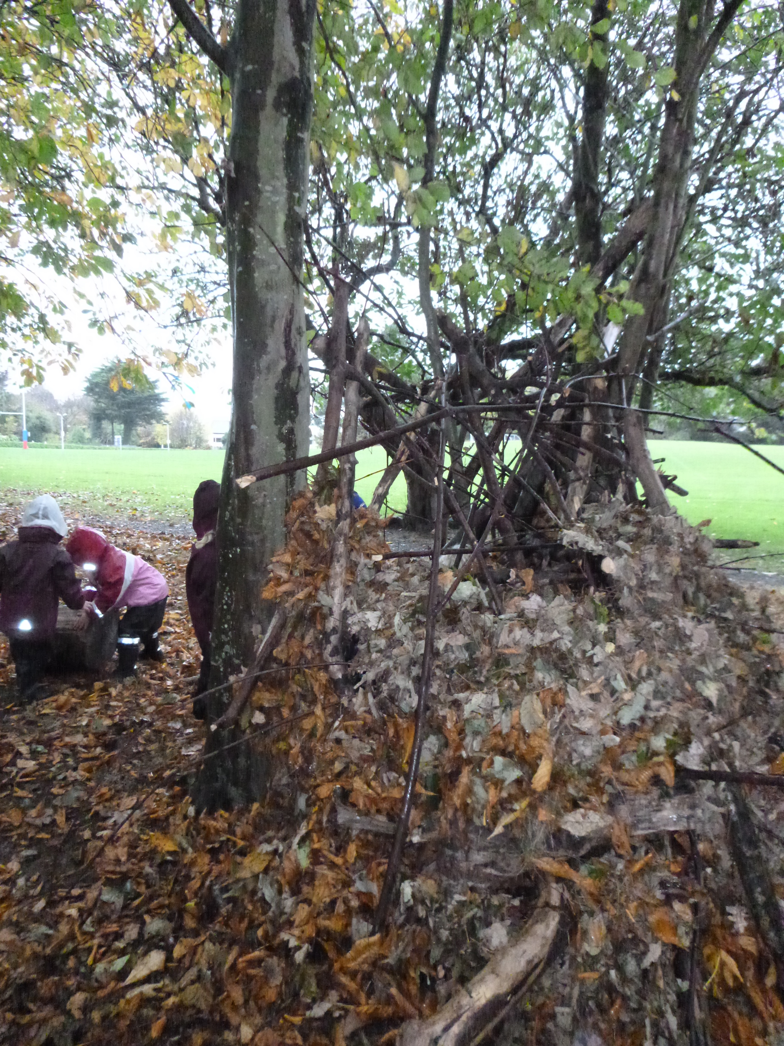
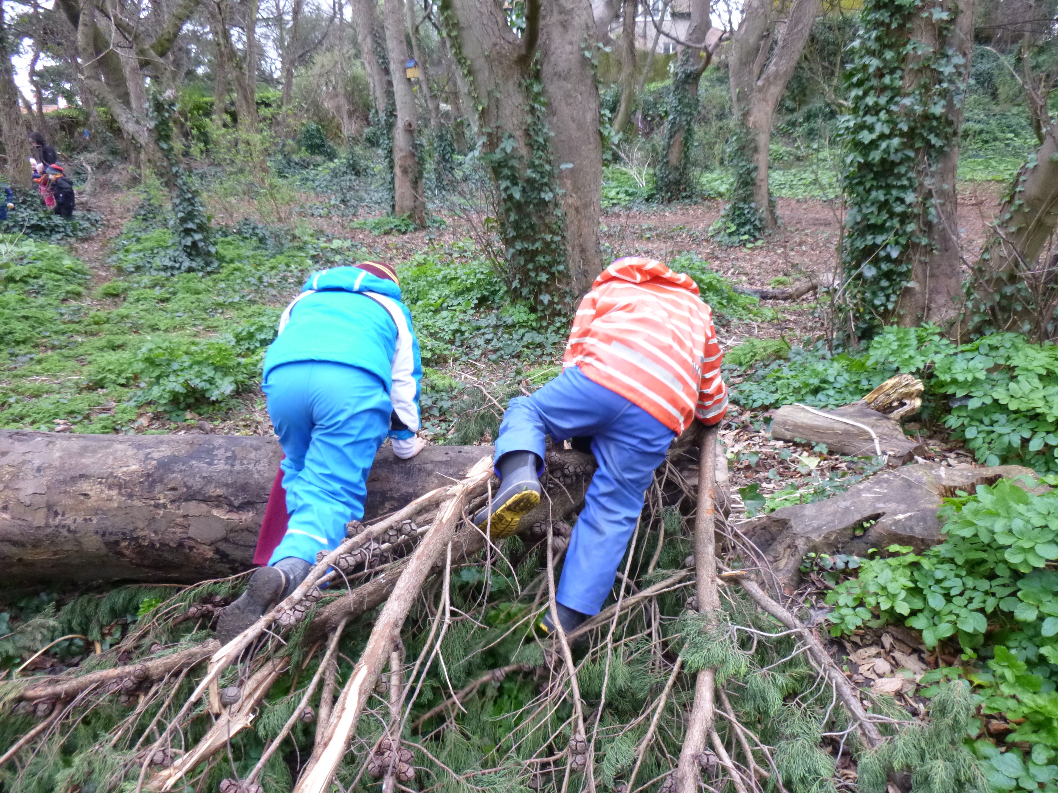
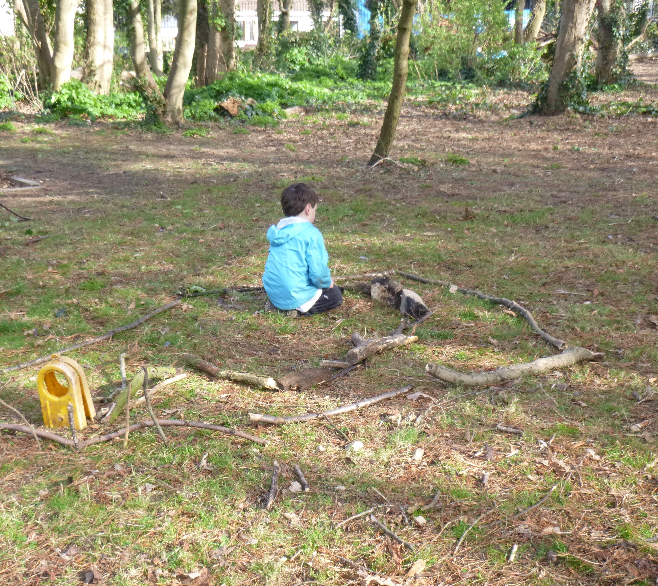

Slide 12
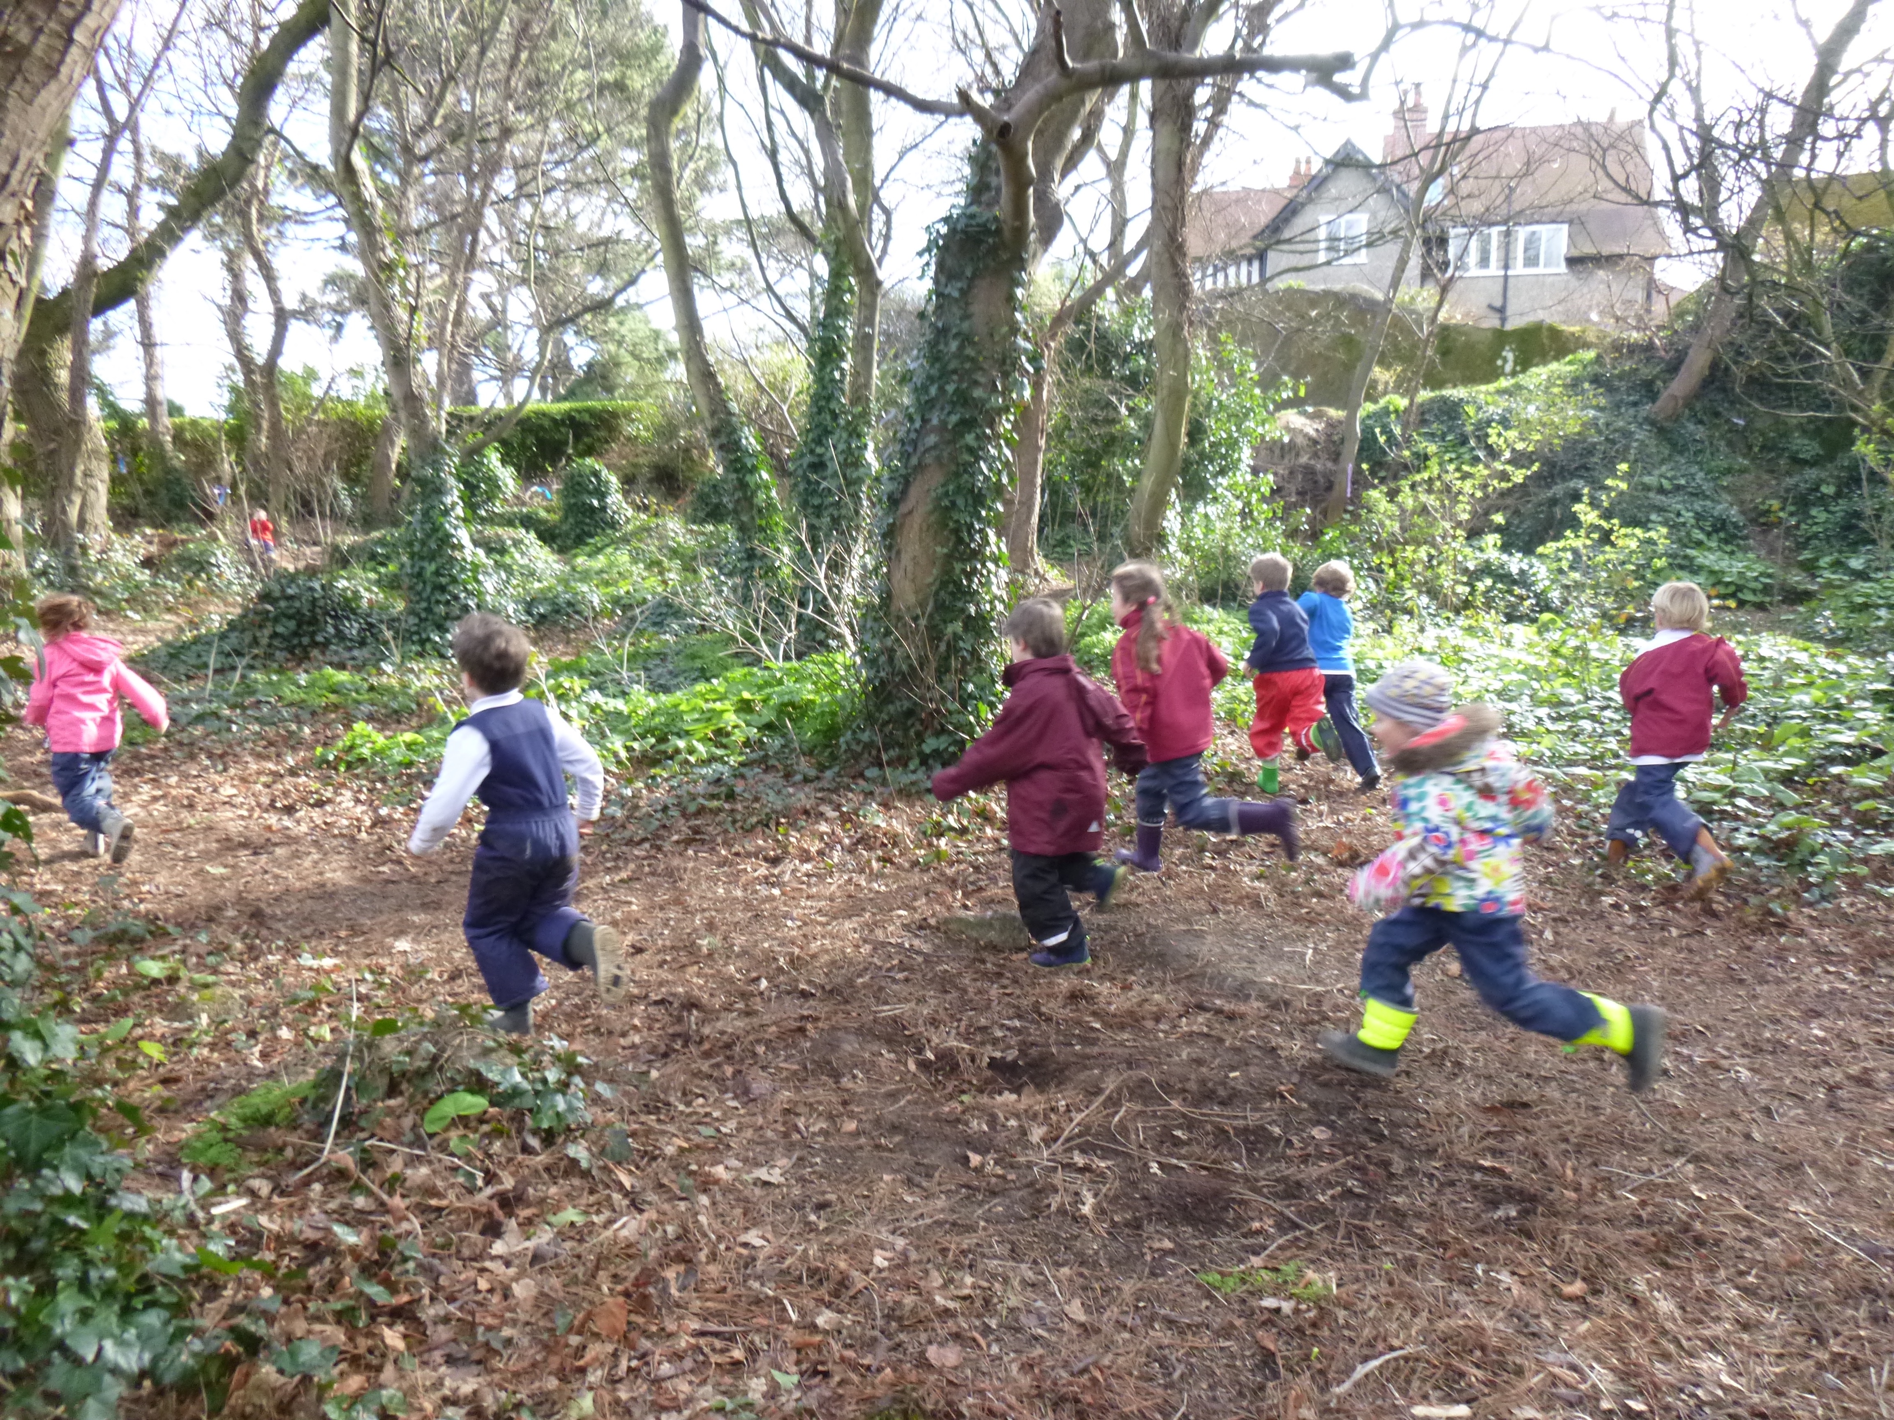
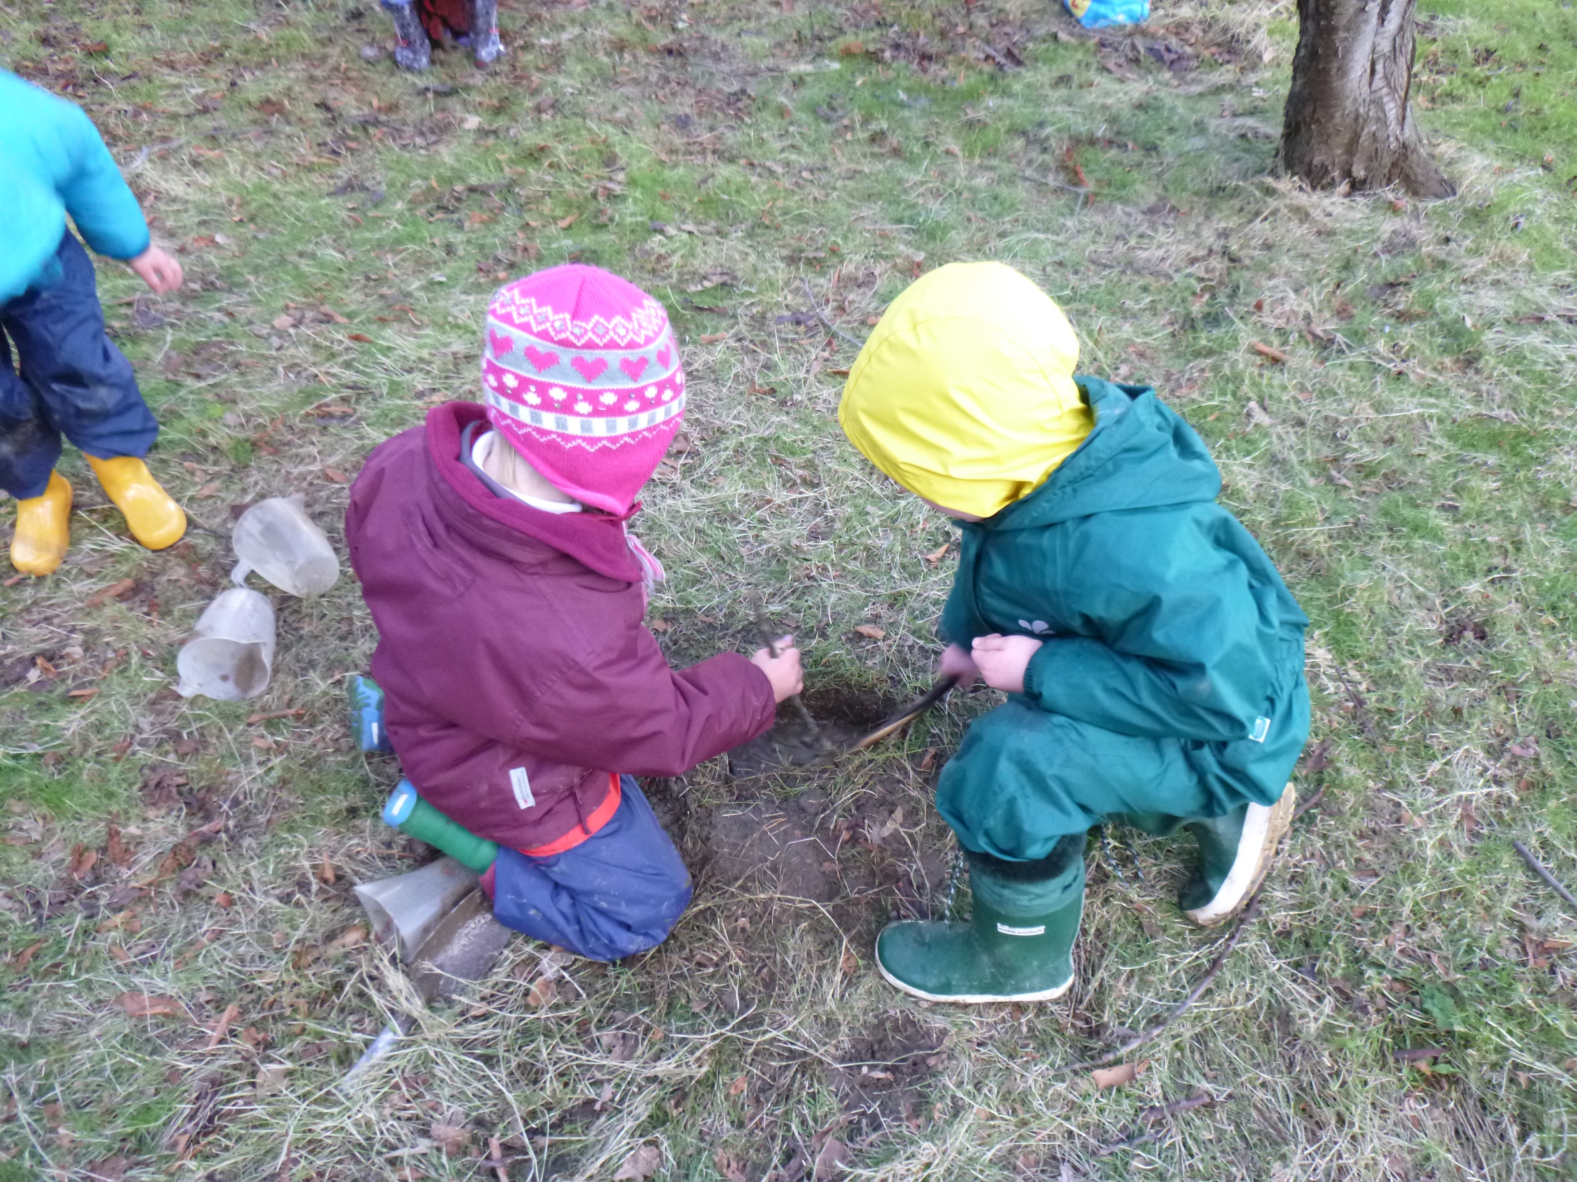

Slide 13
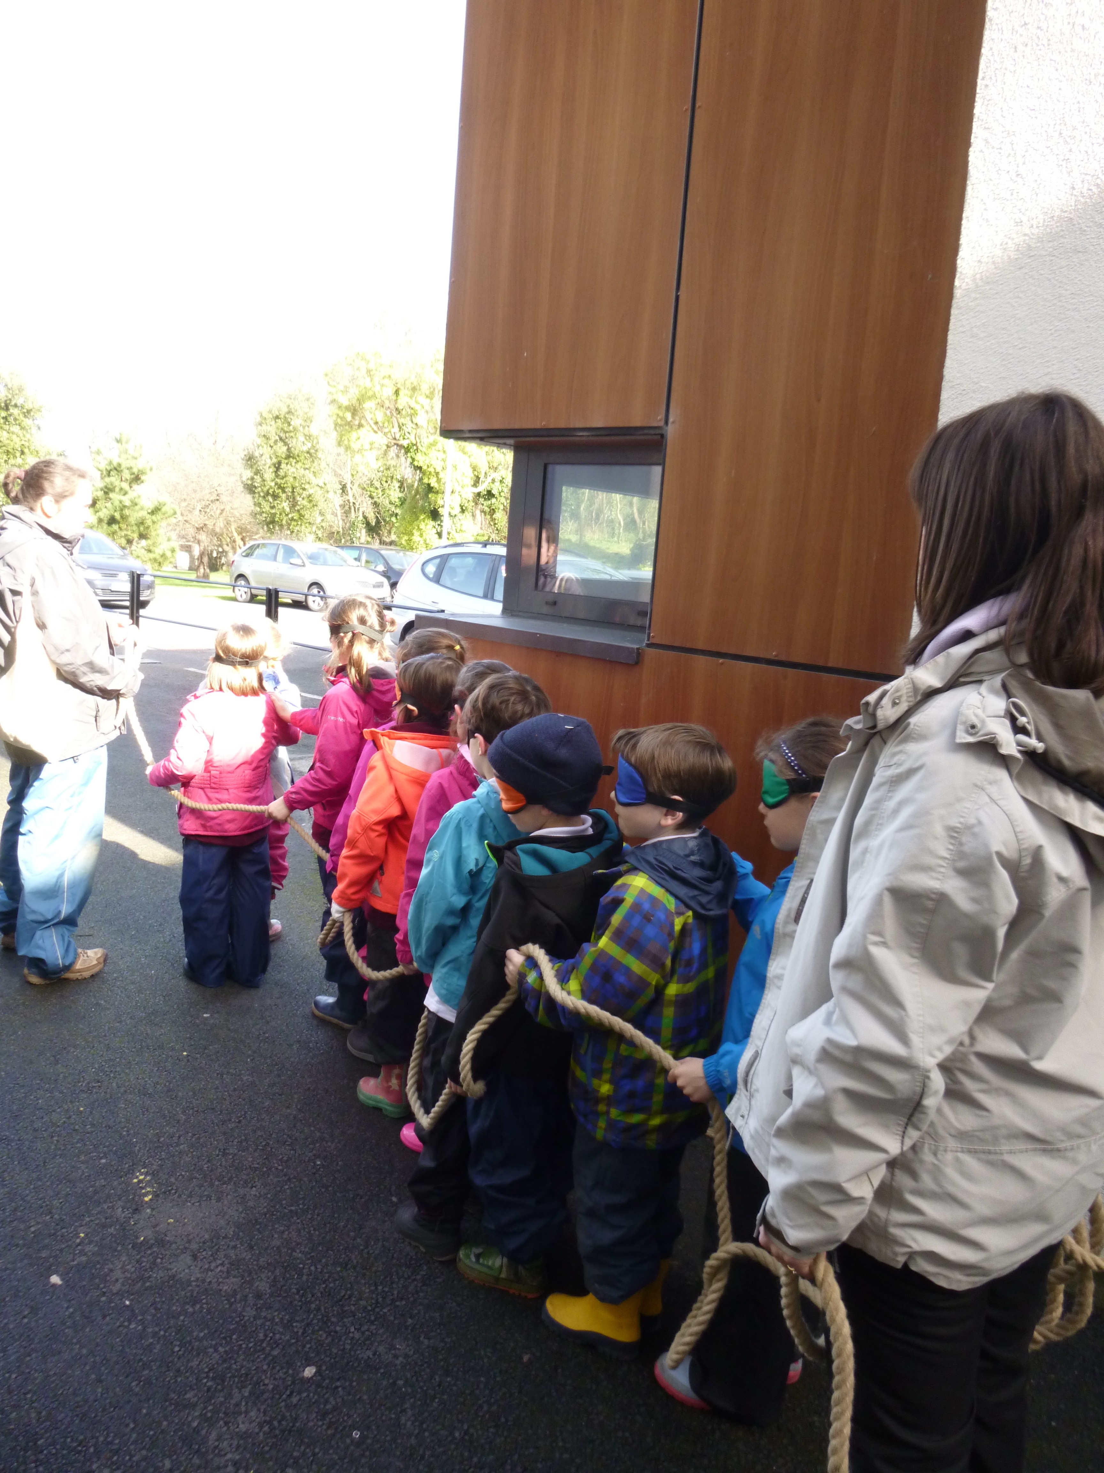
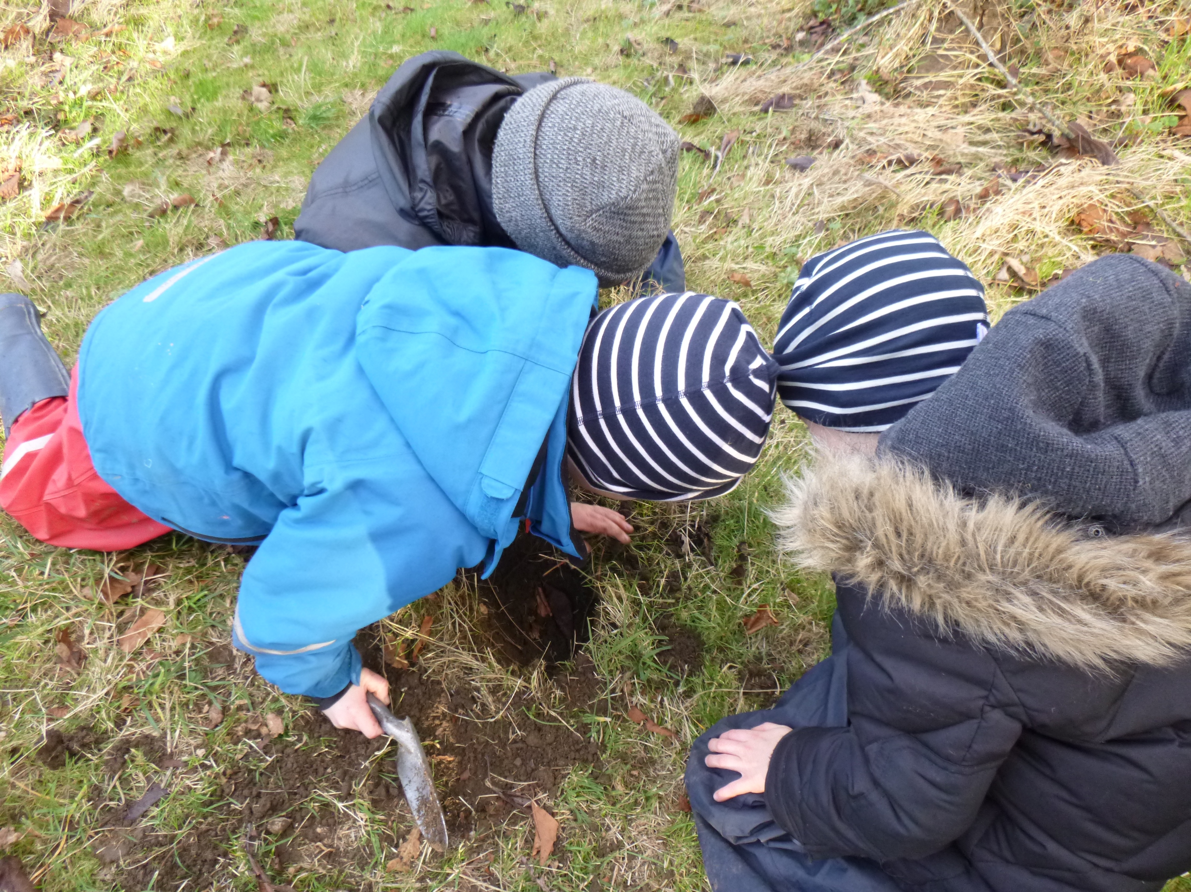

Slide 14
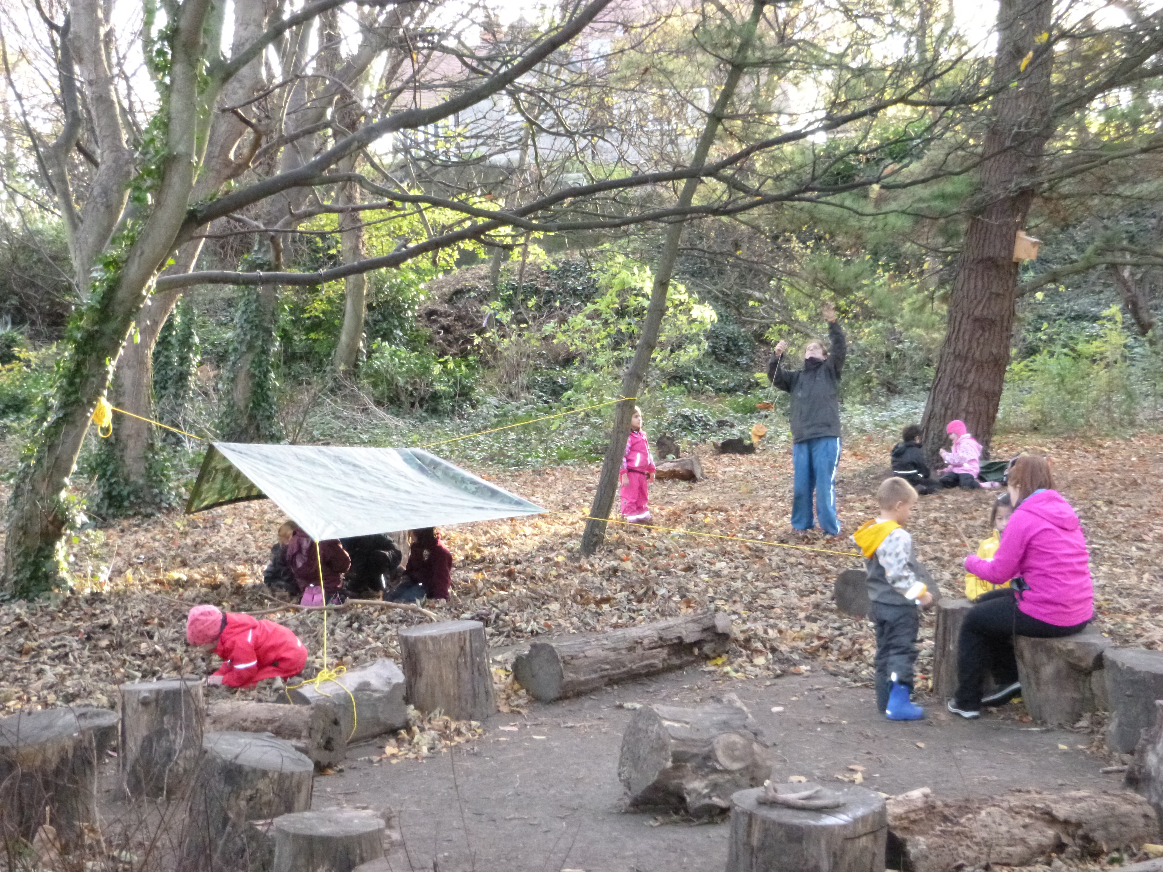

Slide 15
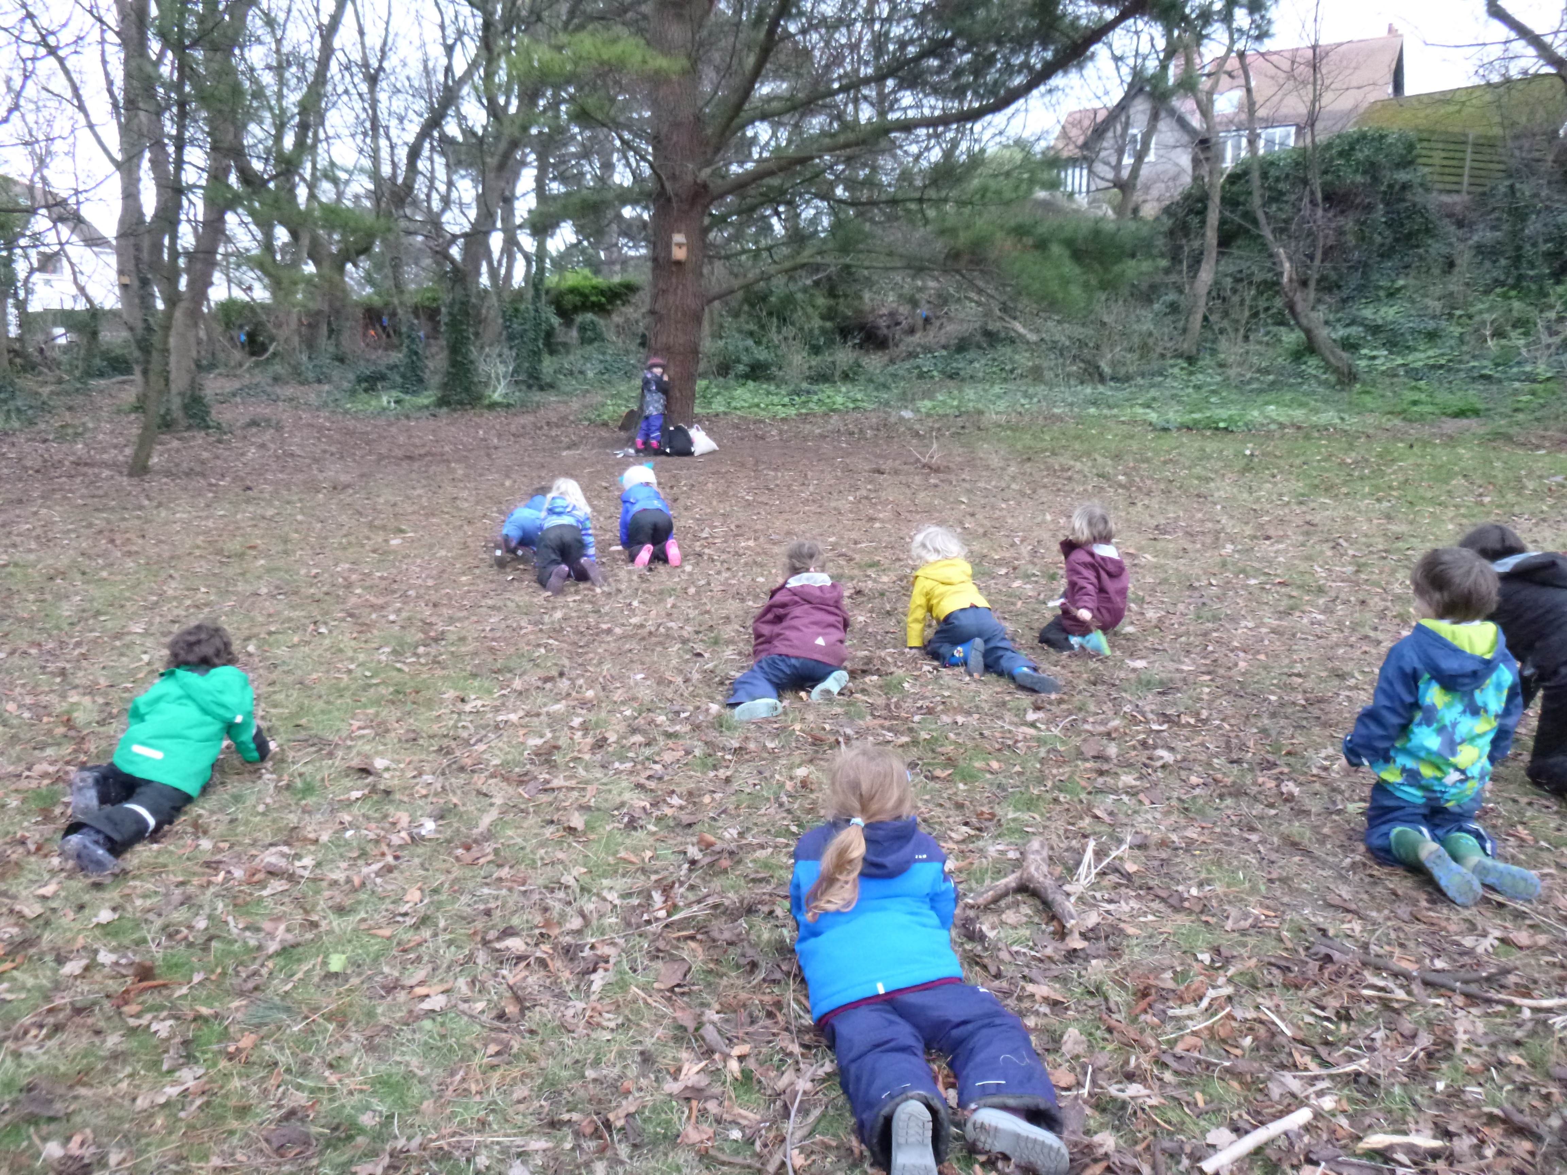
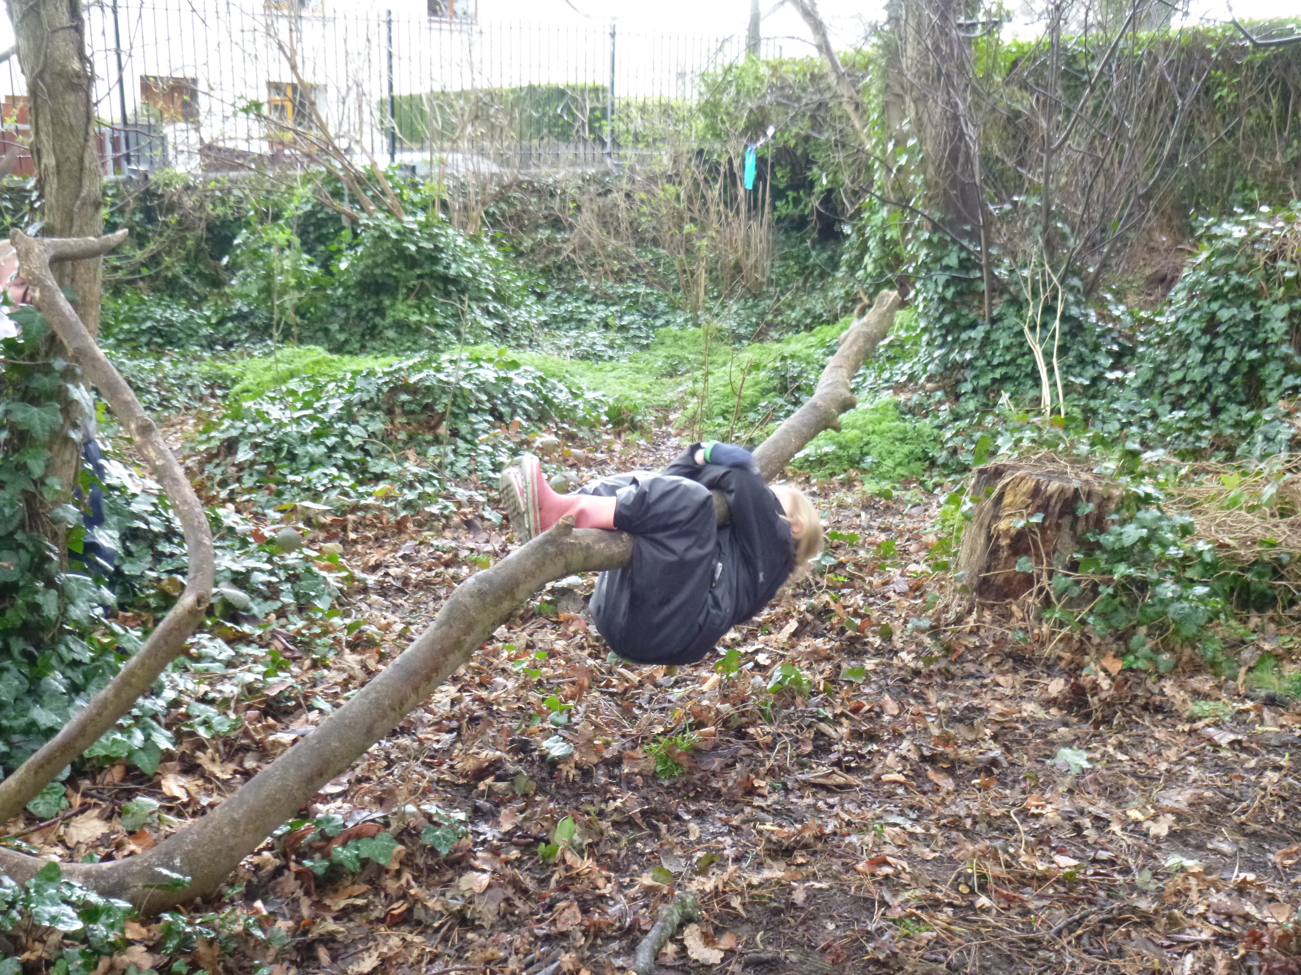
Thank You ☺

