Slide 1
How does Steiner’s learning theory help us understand and support a child’s holistic development in forest School?
Presented by: Mary-Rose & Louise

Slide 2
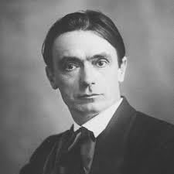
Introduction to steiner theory
Educational principles based on his own personal philosophy – Anthroposophy
Creative, spiritual and moral given as much attention as intellectual
Education should mirror a child’s developmental stages

Slide 3
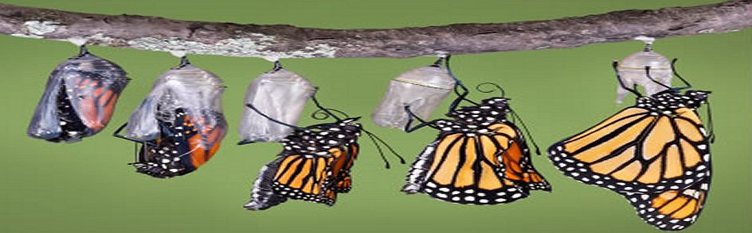
Stages of a child’s development
0-7 yrs 7-14yrs 14-21yrs
Kindergarten
Elementary
Upper Grades

Slide 4
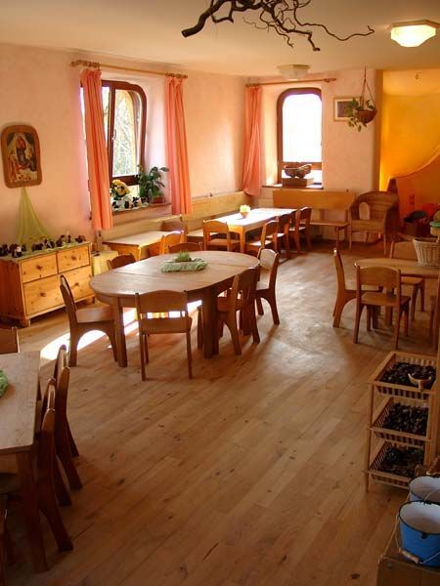
Steiner school
Simple, unfinished wooden toys vs. Bright plastic ones
Emphasis on arts & crafts and outdoor education and gardening
Importance of celebrating festivals and routines
Relationship between teacher and child is important.

Slide 5
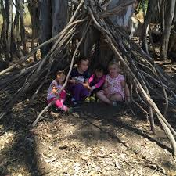
Forest school
Forest School gives children the opportunity to collaborate on tasks and learn together outdoors
Child led

Slide 6
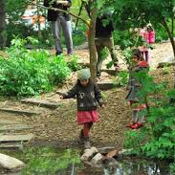
Child-led methodologies
Promote holistic development
Develop connections to the world around them

Slide 7
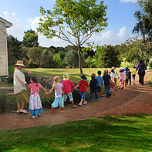
Receive the child with reverence, educate with love, let go forth in freedom
- Rudolph steiner

