Slide 1
Woodland Management
Resources to hand:
*12 steps to making woodland management plan
* Site appraisal form
12 Steps to Making a Woodland Plan for your Forest School Site
Notes:
Hi everybody,
Welcome to your session on woodland management.
We are going to go through the 12 step plan for making your woodland management plan for your forest school site
Practicalities:
You might like to take notes – or just listen – this powerpoint is available on online resources so you can get the links etc afterwards
You will need the 12 step woodland management plant – if you want to refer to it
Site appraisal form – both of these are in your FS Handbook
I will go through the first half of the sessions, and mid way through I will take a couple of minutes break –to take questions – and a break from hearing me talk!
Then I will do the 2nd part of the session – and can take questions at the end again.
(Next slide) To start and to get your brains in gear – I want you to think back to our session on woodland ecology on the training back in March – can you remember one thing form the session? If someone would like to start – and then they can pass it onto the next person

Slide 2
A little brain warm up!
Re-introduce yourself and buddy break out (10 minutes)
What do you know about ecology in Portugal?
1 Forest School thing you feel confident
1 Forest School thing you want support with
Notes:
To start and to get your brains in gear – I want you to think back to our session on woodland ecology on the training back in March – can you remember that day?
Can you remember one thing from the session?
If someone would like to start – you can unmute and throw out what you remember- it can be anything!
And then they can pass it onto the next person – if someone can think of something you can raise your hand to help the person pass it on to someone who is ready!
I only need a few suggestions – not everyone has to go!

Slide 3
Woodland Management – (Unit 4 & 2)
Forest School Programme: Planning and Preparation (Unit 4)
Forest School Programme: Woodland Environment (Unit 2)
2. Be able to manage the ecological impact of a Forest School programme. | Assess the ecological impact of running Forest School Programmes on own site. Use the ecological impact assessment to create a three year management plan for the sustainable use of own Forest School site and to enhance biodiversity.
3. Understand the management of woodlands as a sustainable learning environment. | Describe woodland management methods and their significance to sustainability. Explain ways to involve participants in sustainable woodland management on a Forest School site.
Notes:
Today we are looking at Woodland Management
This links in with 2 different modules.
It links in with the Planning and Preparation module –where you are looking at planning your Forest School Pilot programme – when you have identified your forest school site
You will need to carry out an ecological impact assessment of the woodland – in advance of running the programme
Create a 3 year woodland management plan – based on ecological assessment
for the sustainable use of your forest school site & to improve biodiversity
It also comes in under the Woodland Environment module:
– where you need to gain an understanding of how to manage a woodland sustainably
- this parallels the work you need to do for your pilot.

Slide 4
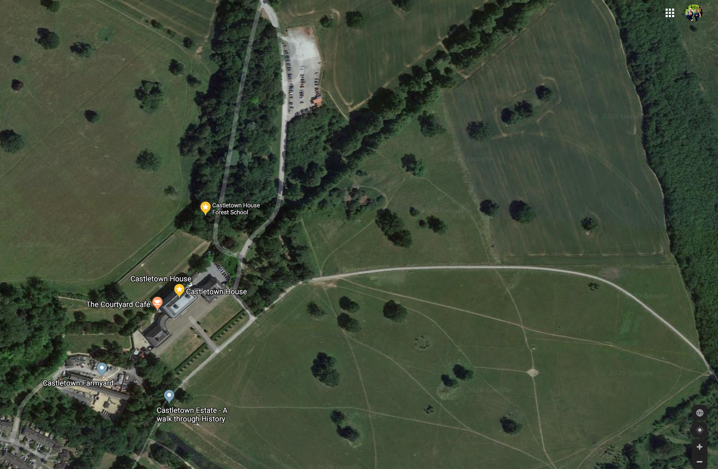
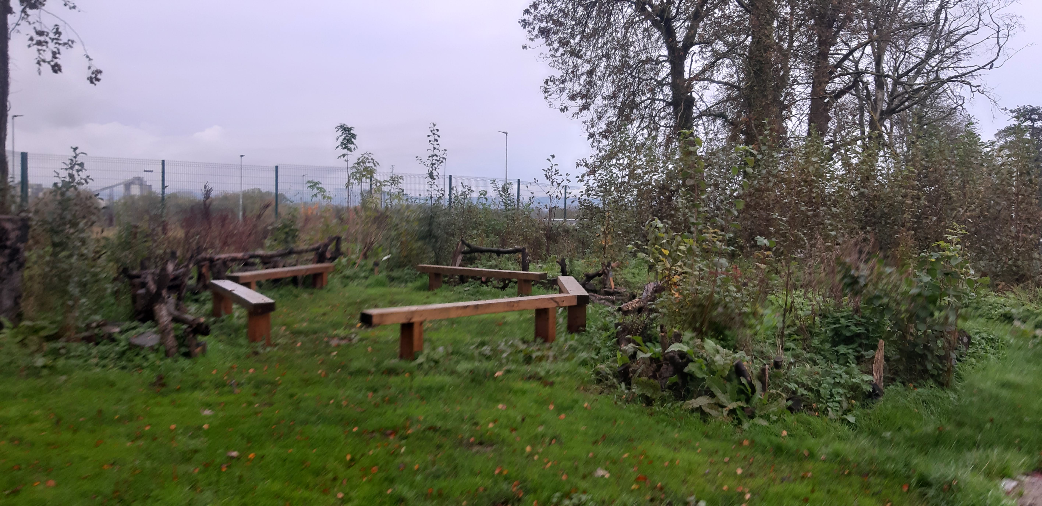
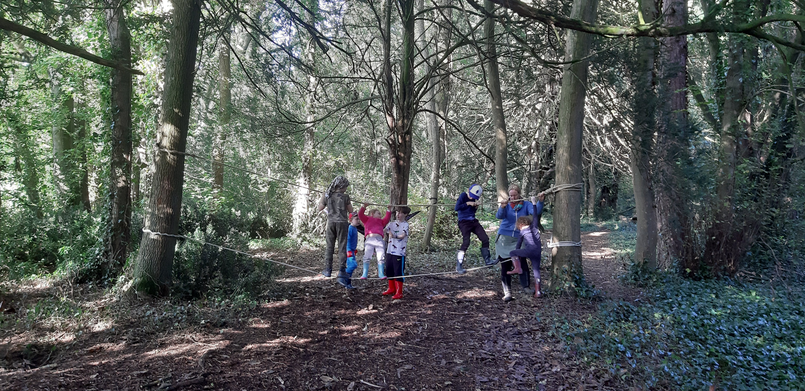
1. Find a Woodland or a suitable site
Start to use Site Appraisal Form
Urban primary school with new young woodland and seated area for Forest School
Woodland based forest school at Castletown House
Google Maps view of Castletown House and lands
Notes:
*Pull out your 12 steps to making a Woodland Management Plan
Step 1: Find a woodland
Your first step towards running your pilot programme or future forest school programmes
- is to find the woodland you are going to use for your pilot project
- this is also connected in to identifying what group you want to work with
This might be different for everybody depending on where are you:
If you are a primary or E.Years teacher - Is it going to be part of your Early years Service or Primary School?
If you are freelance- you might be looking at using a - Local park, part of the grounds of an organisation/public amenity woodland?
Site affordance - every site will be different – not every site will have lots of mature trees, it might be urban setting, young woodland etc. every site will have it’s positives and it’s shortcomings – but through this process you will find out its possibilities
When considering your Forest School site - Think about location-accessibility etc.
(Next slide) Use site appraisal form for this – asks relevant questions to make you think about practicalities to the site – can the parents park nearby, can the school bus park within walking distance of the site.

Slide 5
Site Appraisal Form – see your PDF from email
Covers 3 main assessments of site:
Access
Walking distance to car park - Drop off/pick up points
Access to site - network of paths-durability of site
Site - ground cover, boundaries, base camp, suitable shelter, toilets nearby
Site Character
Feel of the site – noise levels, traffic, maturity of trees, shrub layer, stumps, fallen trees, variety of plants, potential materials on ground for crafts etc, variety in the places, multi-sensory, water, mixed terrain, site aspect, historical remains
Potential Hazards
Public space – litter, dogs, security of area, passers by
Environmental - Water, standing dead wood, steep drops, harmful plants
Management- site work by landowner, phone connectivity, local pollution, nearest doctors/hospital
Notes:
Use site appraisal form for this – asks relevant questions to make you think about the various aspects of your potential forest school site – can the parents park nearby,
Does it take 20 minutes to walk to the site? Can the parents park nearby? Can the school bus park within walking distance of the site? If so, can you find a better location nearer a car park or accessway.
Are there hardly any trees – how can you make that work, can you plant trees and start a young woodland?
Are there any major hazards to be considered?
- If you are in a public space –you will need to litter and dog poo check every week before the session starts
– a deep drop just out of site of basecamp?
What age group are you going to be working with –does it suit this?
Are you in a public space –will there be members of the public and dogs walking through the site?

Slide 6
2. Get Permission - Land Manager
Complete Site Appraisal form
Restrictions/Existing Management Plan for Castletown House:
Land & House owned & managed by OPW
Liaise with Site Manager/Events manager – agreed terms for project
FS Site Survey & Site Risk Assessment completed by Head Horticulturist (HH). & by Growing Wild, Growing Wild signs off on Site Risk Assessment in collaboration with HH.
Woodland management specifics for CH:
No fires allowed – so no impact on ground at site
Protection of ancient yews & their roots- Ground impact – CH staff add a layer of bark much 1-2 times/year depending on site ground impact
Invasive species management with CH staff – laurel, rhododendron, sycamore and snowberry can all be cut and used for FS projects.
Native species to be protected – not cutting holly/ native trees
Instructions to parents-route to FS – land ownership issues
Find out who you need to talk to about using your chosen FS site – find landowner/public body/school principal – arrange a meeting to discuss the project
Complete Site appraisal form as part of your preliminary investigations – these help you answer practical questions about the site – is it suitable?
Find out if there are specific restrictions regarding the site/existing management plan for the woodland/environmental designations
Notes:
As part of completing your site appraisal and identifying your woodland you need to get permission to hold your forest school on the site – this is also connected in to identify what group you want to work with.
Find out who you need to talk to about your chosen FS site
Be it a:
Public land – under Coillte or the forestry service, or owned by the OPW
On a school site – meet with principal, talk through project – see if they are open to it?
Arrange a meeting
The site you use might have some specific restrictions – or their own management plan – that you will have to adhere to
– for example in CH FS – I had to…

Slide 7
3. Environmental Designations in Portugal
ICNF | Património natural: http://www2.icnf.pt/portal/pn/biodiversidade/patrinatur
Lista Vermelha da Flora Vascular | espécies ameaçadas, raras e/ou em perigo: http://lvinvertebrados.pt/
Lista Vermelha de Grupos de Invertebrados Terrestres e de Água Doce de Portugal Continental:
http://lvinvertebrados.pt/
Plataforma de informação e ciência-cidadã sobre plantas invasoras em Portugal:
https://invasoras.pt/
Stop Cortaderia, um projeto Life+ para erradicação de uma espécies invasora extremamente perigosa:
http://stopcortaderia.org/language/pt/noticias-pt/
Regulamentos municipais de proteção de arvoredo. Em Portugal ainda só existem dois municipios com
regulamentos prórpios sobre a gestão de arvoredo e proteçao das árvores do seu município:
Lisboa https://www.am-lisboa.pt/documentos/1501328048S2mOT4mu5Sx82IJ4.pdf
e Lousada: https://www.cm-lousada.pt/cmlousada/uploads/writer_file/document/605/regulamento_arvoredo_final.pdf
ICNF | Arvoredo de Interesse Público:
https://www.icnf.pt/florestas/protecaodearvoredo/arvoredodeinteressepublico

Slide 8
European & International designations
International Designations: UNESCO Biosphere Reserve, UNESCO World Heritage Sites, National Park
European Designations: SAC-Special Area of Conservation, NHA-National Heritage Area, SPA’s – Special Protection Area, ESA-Environmentally Sensitive Area
Here the list of the institutional sites with the laws, also derived from UE:
ICNF | Plano sectorial da Rede Natura 2000 http://www2.icnf.pt/portal/pn/biodiversidade/rn2000/p-set
ICNF | Sistema Nacional de Áreas Classificadas: http://www2.icnf.pt/portal/pn/biodiversidade/snac
ICNF | Legislação sobre caça : https://www.icnf.pt/caca
ICNF | Rede Nacional de reservas da Biosfera: http://www2.icnf.pt/portal/pn/biodiversidade/ei/MaB
Notes:
Another thing to consider when choosing your Forest School site is to check whether there are any environmental designations on them
Environmental designations refer to sites that have special protection in terms of conservation status – generally in relation to wildlife, endangered species or specific habitats
e.g. in Kildare we have the Pollardstown Fen
Some other designations – e.g. Castletown House site – is part of Castletown House – Palladian mansions - forest school site is a PINETUM – full of ancient yews and other conifers

Slide 9
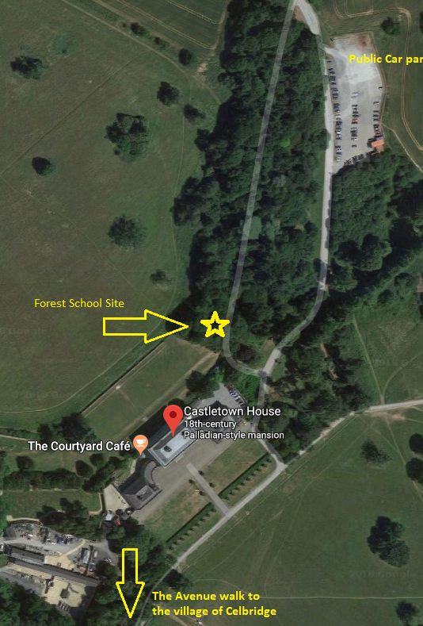
4. Register with myForest – how to…
Registered with myForest - https://sylva.org.uk/myforest/home
Survey of FS site - Download and complete ‘myForest for Education site survey form’
- map/sketch site
- inventory of trees – including tree health assessment (H&S)
- ecological impacts on site
Aids for this – Field Key for tree id/tree disease factsheets/site survey form - how to measure height of tree/tree forms/Site Impact Assessment sheet
Notes:
So, if the whole prospect of trying to come up with a woodland management plan is very daunting – this site can help walk you through the steps of creating your woodland management plan
You can register with this site my Forest – part of Sylva.org.uk – which is the UK forest service.
They have designed this resource in conjunction with Forest School leaders in the UK – so it is tailored for Forest School practitioners
It walks you through the steps you need to complete to survey your forest school site
Registered with myForest - https://sylva.org.uk/myforest/home
Survey of FS site - Downloaded and completed ‘myForest for Education site survey form’
- map/sketch site
- inventory of trees – including tree health assessment (H&S)
- ecological impacts on site
Aids for this – Field Key for tree id/tree disease factsheets/site survey form - how to measure height of tree/tree forms/Site Impact Assessment sheet
Download – step by step guide-to help with next steps
Use MAPPING tool – map FS site OR draw sketch
DATA – add in tree inventory, ecological assessment, work programme
PLANNING - Download plan

Slide 10
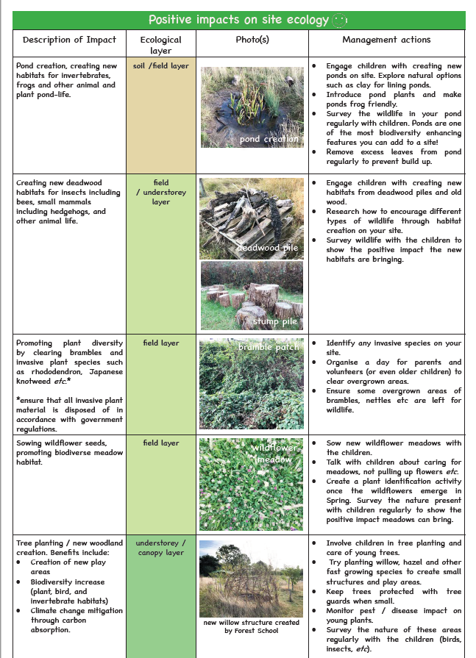
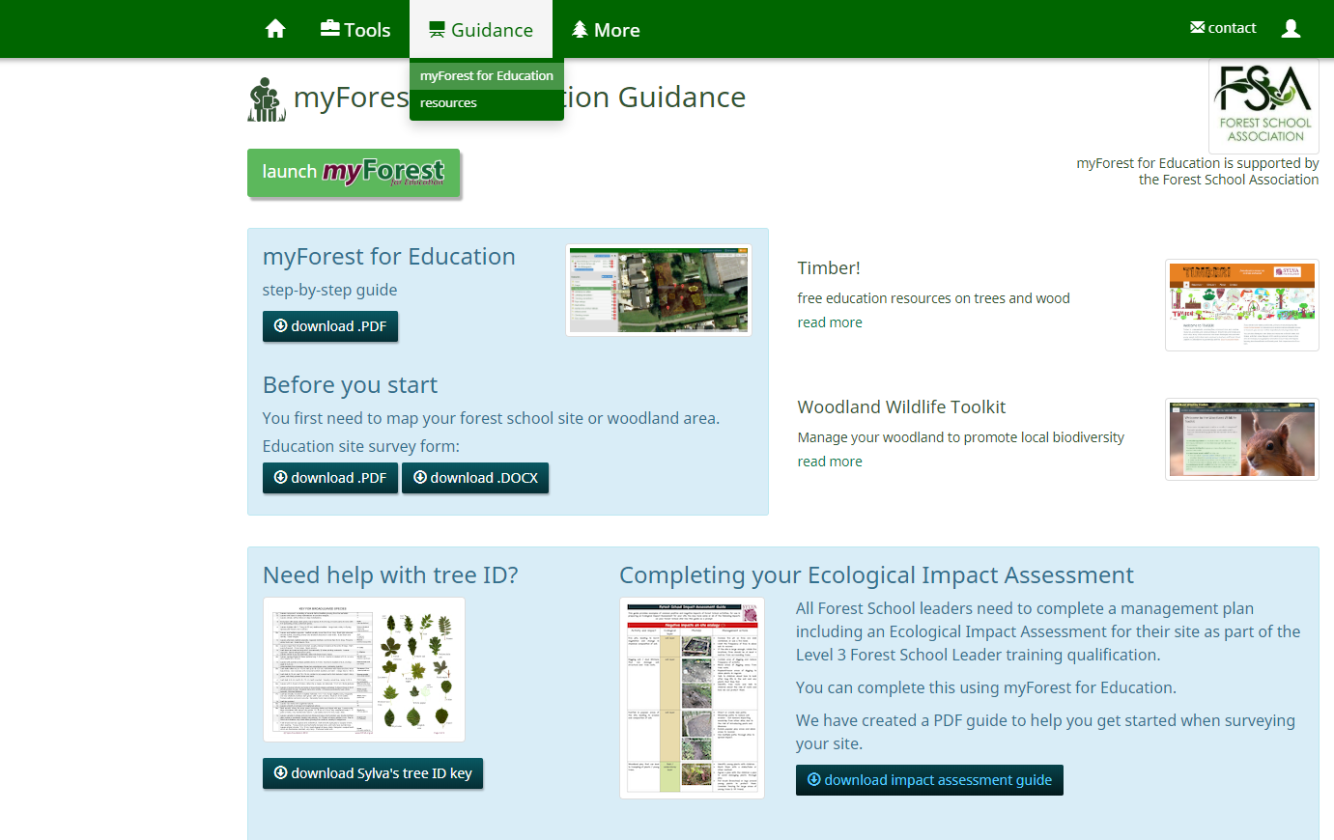
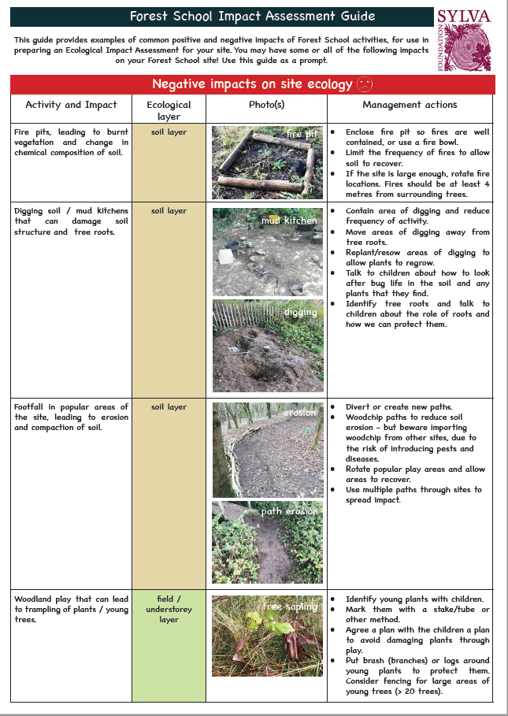
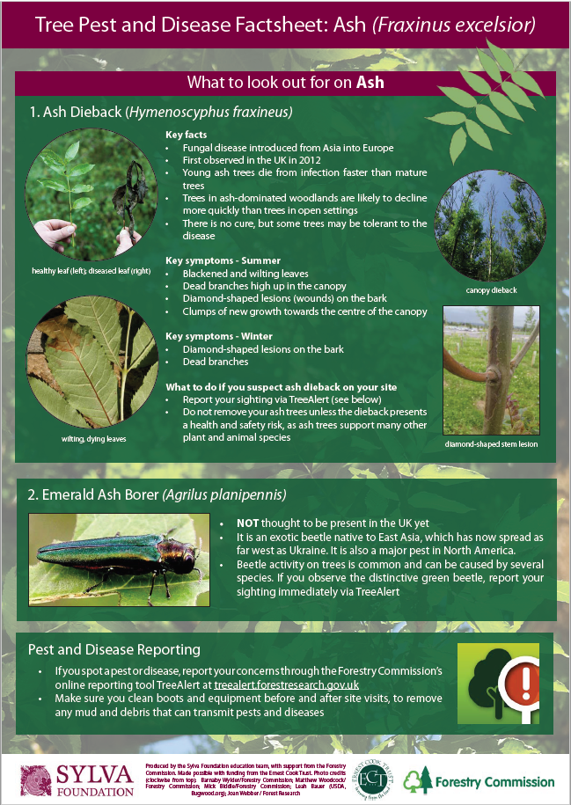
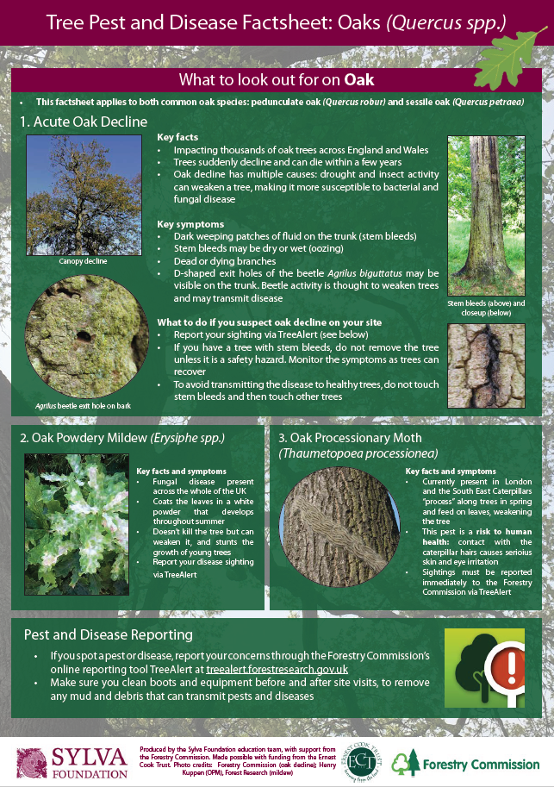
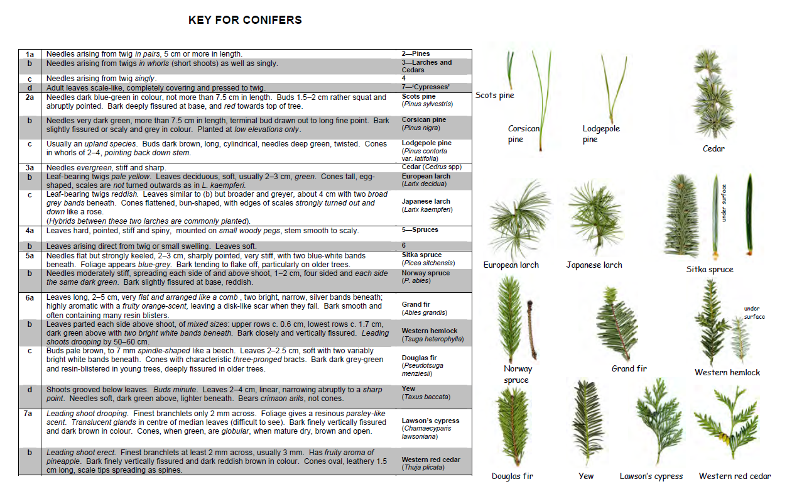
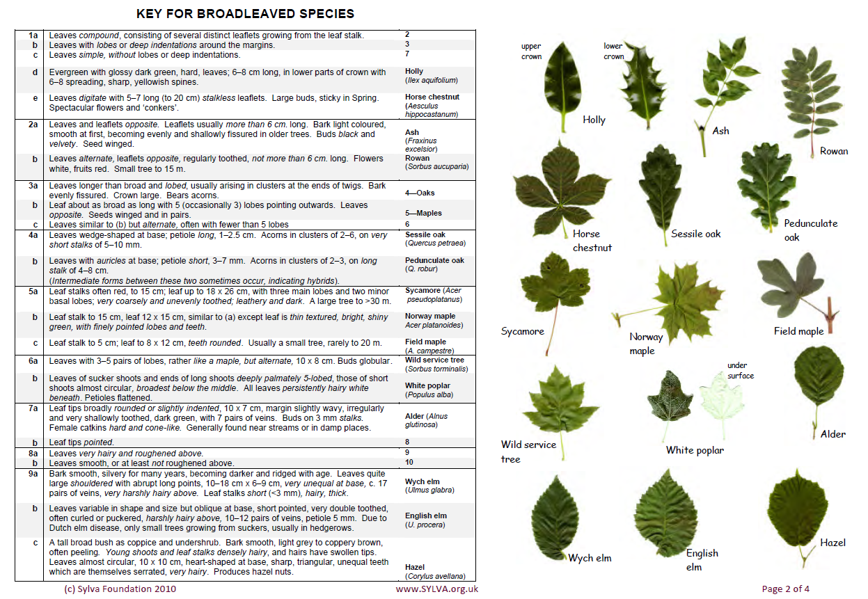
RESOURCES: myForest for Education Guidance
Ecological Impact Assessment Guide
(sylva.org.uk/myforest/education-guidance) Portuguese Resources:
Tree Disease factsheets
Common Trees - field key
Notes:
The myForest website has several resources to help you with your management pan:
Resources:
Handout with lists of possible ecological impact assessments – both positive and negative
A field key for common trees- to hep with your identification
Tree disease factsheets – there is a rise in some specific diseases in relation to ash, horse chestnut, sweet chestnut and oak

Slide 11
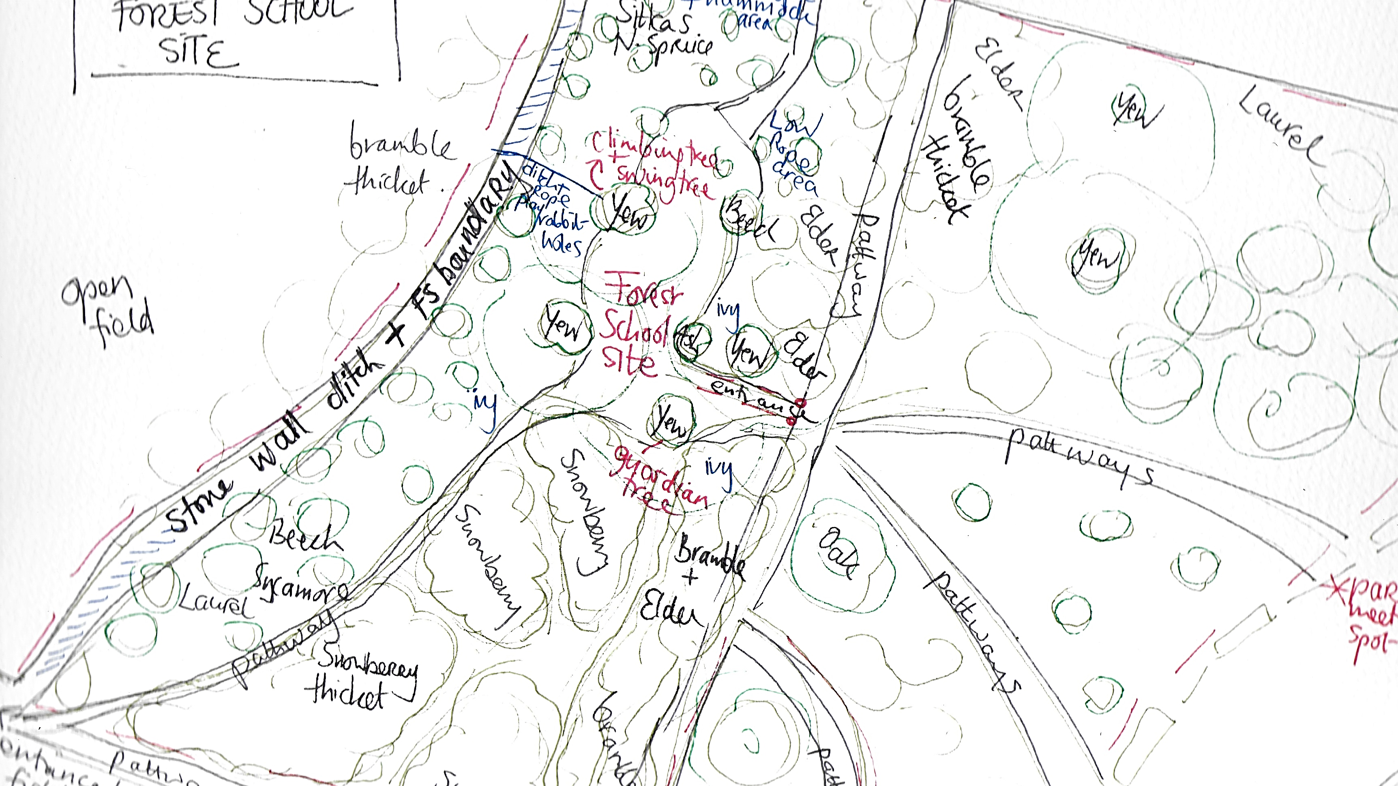
5. Sketch a map of the woods - Forest School Site
Notes:
The next step - as part of the myForest programme is to draw a sketch of your woodland
Mark in as much details as you can
The specifics of the site – where the boundaries are– the major/distinctive trees – is there a stone wall, wire fence, a ditch
Where is your meeting spot going to be?
Where will be the base camp of your forest school?
What hazards are there?.
Try and get as much detail in as possible
You can then map this in on the myForest site -or just use your own sketch

Slide 12
Any burning questions so far?

Slide 13
6. Survey the Trees
CANOPY LAYER TREES ON FS SITE
Name | Info | Dangers | Uses
Common yew (Taxus baccata) | Native, evergreen conifer dominates woodland, dense canopy, spongy, thick fire-proof bark, strong wood. Education around creatures that live in tree-birds nesting in holes in trunk | All parts of tree are poisonous except jelly around seed | Tree/Branch identified for climbing tree, swing and guardian tree.
Oak (Quercus…) | Non-native, broadleaf, deciduous, supports over 300 species | None, not to be cut down | Use leaves for crafts
Ash (Fraxinus excelsior) | Native, broadleaf, deciduous | None, not to be cut down | Leaves for crafts, fallen branches for crafts/den building
Beech (Fagus sylvatica) | Naturalised, supports 45 species | Branch fall – has tendency to drop branches | Beech masts-edible
Scot’s Pine (Pinus Sylvestris) | Native conifer, evergreen |  | Pine needles for crafts
Sycamore (Acer pseudoplatanus) | Non-native-technically invasive species, broadleaf, deciduous | None | Can be coppiced and the branches used for den making, crafts, fire spears etc.
Sitka Spruce (Picea sitchensis) | Non-native, evergreen conifer |  | Needles for crafts, shelter building, needles make delicious tea
Douglas Fir | Introduced, evergreen conifer
Monterey Pine | Introduced, evergreen conifer
Silver Fir | Introduced, evergreen conifer
Western red Cedar | Introduced, evergreen conifer
Holm Oak | Introduced, evergreen oak
Lawson’s Cypress | Introduced, evergreen conifer
What trees are in your FS area?
Edible/useful /poisonous
H&S – survey trees for dead/dying/dangerous
What management needs to be done?
Notes:
After completing your sketch
Carry out a survey of the trees in your forest school area
Try and identify them – this is important in terms of knowing the trees that have poisonous elements – are the berries poisonous etc. and which have uses for your forest school programme e.g. elder and willow for charcoal and elder pencils
This table looks at the trees in the CANOPY LAYER of my forest school – the larger and taller trees- that form the canopy of the woodland
I made this table up – breaks it down into 3 sections- 1. info 2.dangers 3.uses
The myForest also has a template for a tree survey

Slide 14
Shrub Layer
Name | General Plant Info | Dangers | Forest School Uses
Elder (Sambucus nigra) | Native shrub, low growing, soft stems | Stems & branches not safe to eat – don’t use for marshmallow stick | Elderberries - edible (when processed)- syrup-wild ink. Elderflowers – can be processed into cordial. Soft stems – used for elder pencils
Snowberry (Symphoricarpos alba) | Invasive species The leaves of Snowberry are a larval foodplant of the Death's Head Hawkmoth. Berries eaten by pheasants and grouse. | The berries are poisonous to humans. | Can cut and use branches for crafts/dens etc. kids cut pathways through it and have secret hideaway spaces in it.
Holly | Native broadleaf evergreen | Not edible, spiky leaves | Not to be cut, small amounts for Xmas decorations ok.
Sycamore | Invasive species, good for coppice wood and wood crafts | Not edible. | Can be coppiced – good use for crafts etc.
Cherry Laurel (Pruno Laurocerasus) | Invasive species, evergreen | ALL PARTS poisonous. Not to be used for coking rods. | Ok to cut back to the ground – helps with woodland management. Can cut and use branches & leaves for den building
Rhododendron (Rhododendron ponticum) | Invasive species, non-native, has taken over certain areas in Ireland, e.g. Killarney National Park. Attractive evergreen shrub, with masses of pink-purple flowers in summertime. | ALL PARTS poisonous. Not to be used for coking rods. | Ok to cut back to the ground – helps with woodland management. Can cut and use branches & leaves for den building
Bramble | Native, evergreen, ground spreading creeper, large spikes. | Very spiky thorns. Ok to cut small amount to clear pathways/potential eye hazards. | Edible berries – good for wild inks, natural dye/paint, for FS cooking projects – blackberry pancakes, bramble tip tea
Shrub layer trees on site:
Elder
Snowberry
Laurel
Rhododendron
Holly
Bramble
Notes:
This table looks at the SHRUB LAYER of the woodland –the tree and shrubs that make up the middle layer of the woodland – they tend to be small to medium shrub/small trees
Same template as before 1. info 2. dangers 3. uses

Slide 15
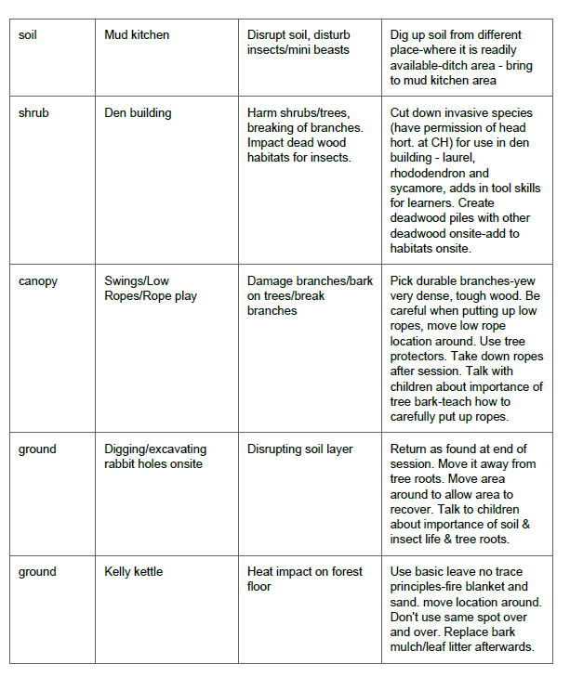
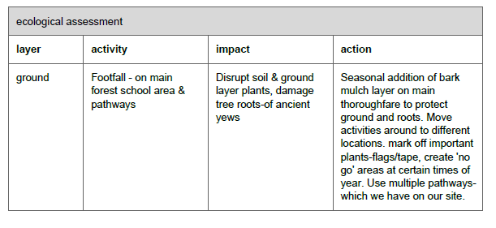
7. Do an Ecological Impact Assessment:
*From myForest Mgt Plan
*Resource on myForest
Notes:
You have completed your survey of the trees and the flora & fauna of the site (some of this might happen over a longer time)
Now you move onto looking at the ecological impact assessment
There is a template in the myForest – which helps you complete this
and a Handout on Ecological Impacts with the positives and negatives to help you brainstorm
Make a list of the possible activities that will occur at your forest school
– then assess them for their impact – this can be positive or negative
- and what action you are going to take to manage that impact

Slide 16
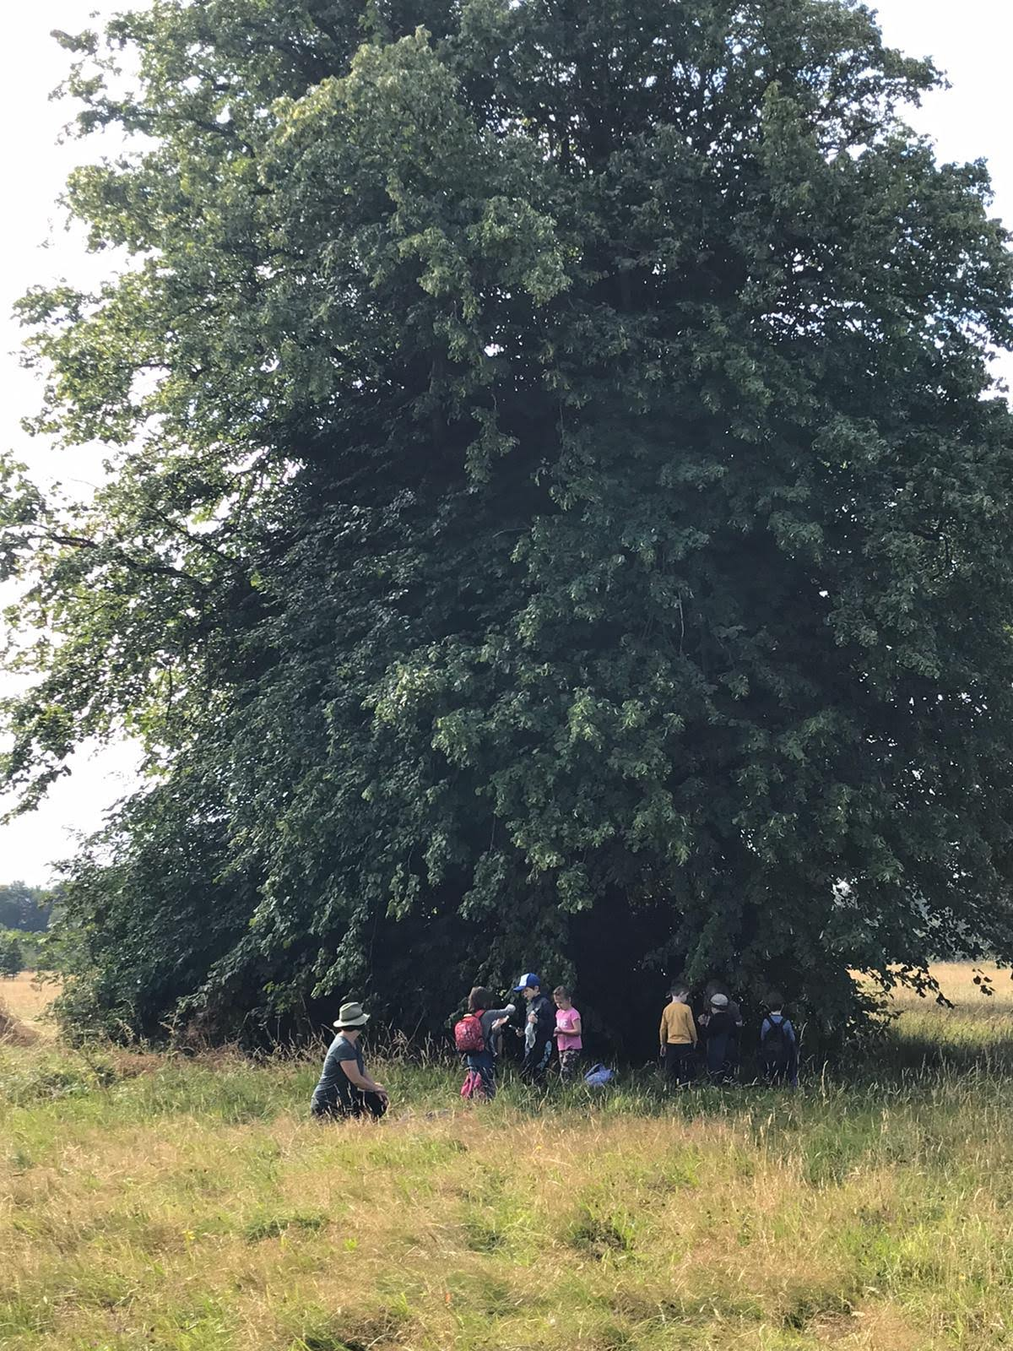
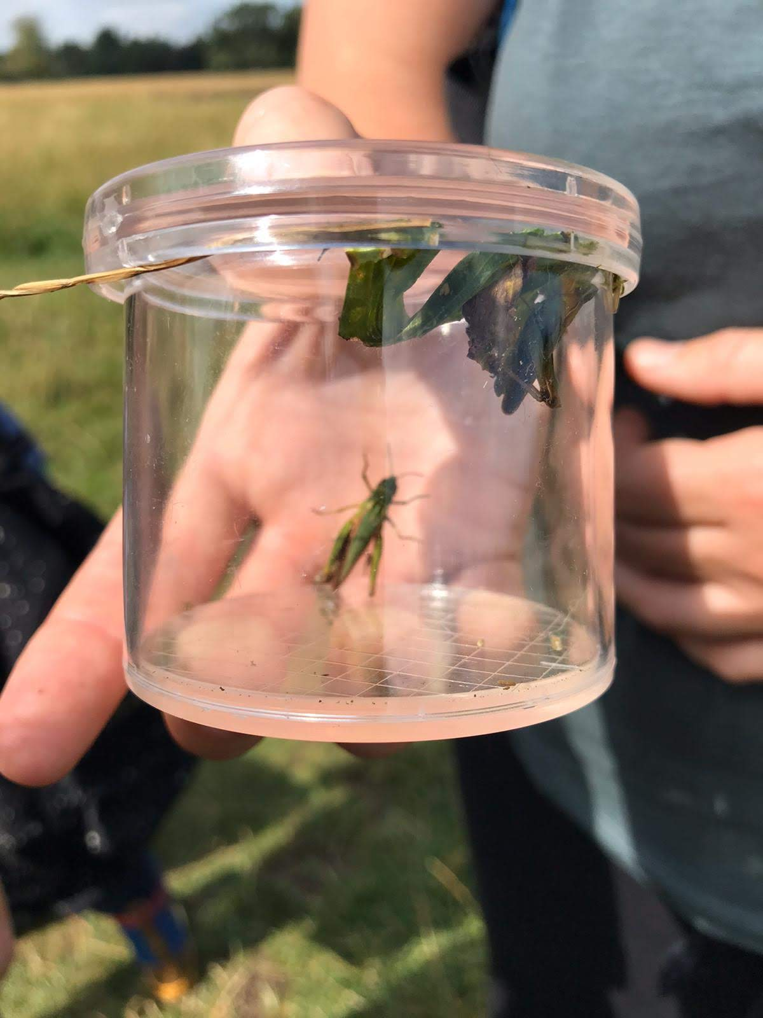
8. Do a basic survey of Flora & Fauna
NB. As part of your woodland environment module – identify a range of woodland flora & fauna
 | FLORA | Any comments
1 | Lords & Ladies (Arum macculata?) | Comes up in February-the leaves first – need to show to children so they can recognise – poisonous plant
2 | Nettles | Come up in spring – we make nettle pesto from them!
3 | Cleavers | Great sticky back fights between the kids!
4 | Dog violet | Take part in Spring watch?
5 | Herb robert | Part of the wild geranium family
6 | Maidenhair fern
7 | Harts tongue fern
8 | Bracket fungus
9/ 10 | Others found:
 | FAUNA | Any comments
1 | Robin /Coal tit/blackbirds | Come to visit while we are there – were very friendly when we were making bird feeders from pine cones, fat & seeds
2 | Grey squirrels | Full of grey squirrels – they occasionally do some dramatic swinging through the trees when we are there
3 | Rabbits | Old rabbit burrows onsite - seem to be disused
4 | Bats | During our winter sessions of FS we used a bat detector in the field and identified a soprano pipistrelle flying in the field just behind out site
5 | Foxes | We spotted tracks in the mud just at the edge of out site -more explorations to follow…
6 | Worms | Found when we do some bug hunting on the ground
7 | Ladybirds | Found a 14-spot yellow!
8 | Woodlice | Found when we do some bug hunting hiding in the dead leaves on the forest floor and nestled in the base of the trees.
9 | Field Grasshoper | Found out in the field during our summer camp – field grasshopper
10 | Others found:
Bug Hunts with FS participants
Notes:
As part of your woodland environment module -you need to
‘identify a range of woodland flora and fauna for your own site’
This is where you can complete this: very simple template that I created – can create your own
Pick 10 flora – plants
Pick 10 fauna – animals, insects etc.
*This can happen more slowly – over your first year of your forest school programme – as you see the site through the seasons

Slide 17
Useful Resources – for identifying flora & fauna & exploring biodiversity in Ireland!
Tree Council of Ireland– primary school children’s resources for activities in native woodlands - https://www.treecouncil.ie/
OPAL (NI)– www.opal.org - wildlife & flora Id & resource sheets
LEAF Ireland – www.leafireland.org resources – habitats mapping/site mapping/biodiversity assessments/seasonal ID charts
National Biodiversity Data Centre – www.biodiversityireland.ie , www.pollinators.ie – citizen science recording, ID charts for insects-bees, butterflies, shield bugs, etc.
https://woodlandwildlifetoolkit.sylva.org.uk/ - link from myForest - UK species
Notes:
Some useful resources to help you with your flora and fauna ID

Slide 18
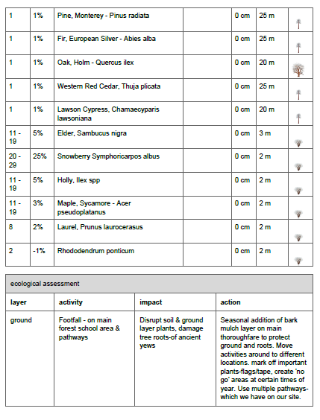
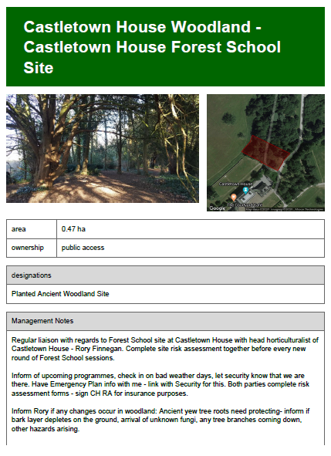
9. Input data – Plot map on myForest
myForest-Woodland Management Plan
Notes:
After you have completed your:
Sketched & mapped your site
Tree survey
Ecological impact assessment
Flora & fauna survey
You input all this data into your myForest account and it generates a woodland management plan for you
This is the Woodland Management plan for my Forest School site at Castletown House - there are a few extra bits like –
Management Notes - the management of the site –which relates to what are the agreement you have with landowners (step 2)– their management rules for the site
Site history – it’s good to look into the history of the site

Slide 19
10. Ideas to help improve/maintain biodiversity
Tree Nursery – saving & planting local seeds from local woodlands
Plant trees - plant a mini native woodland from seeds you saved
Coppice plants – taking cuttings - elder/willow
Planting wild plants – edible – wild garlic, tri-cornered leek (invasive)
Wild Areas – encouraging wild area - not walked on- fenced off - sow wildflower seeds (be careful with this)
Water area – dig a pond
Log piles
Other habitats – woodwork projects - bird boxes & nesting boxes, ladybird house, bat boxes, butterfly house, hedgehog hibernation box
Re-Wilding – fence off area - let nature do it’s thing – lack of total wilderness left in world
Notes:
Something else to think about – layers in with ecological impact on FS site
Biodiversity –which is interlinked with the woodland ecology is a really important aspect to add to your woodland management plan
Think about how you can add to or enhance your site in terms of biodiversity
Here are a few things you could think about doing…

Slide 20
Biosecurity – key things to think about
Keeping eyes open – for anything unusual - changes in trees etc.
Learning about existing diseases – know your trees
Tree Planting - Provenance – of trees/plants going into ground – where did the plant come from? Europe? Ireland? ONLY USE - Portuguese origin trees
Ponds – don’t move frog spawn – let it occur naturally
Know your invasive species - don’t plant or encourage
myForest - Tree Disease factsheets
Ash Dieback

Slide 21
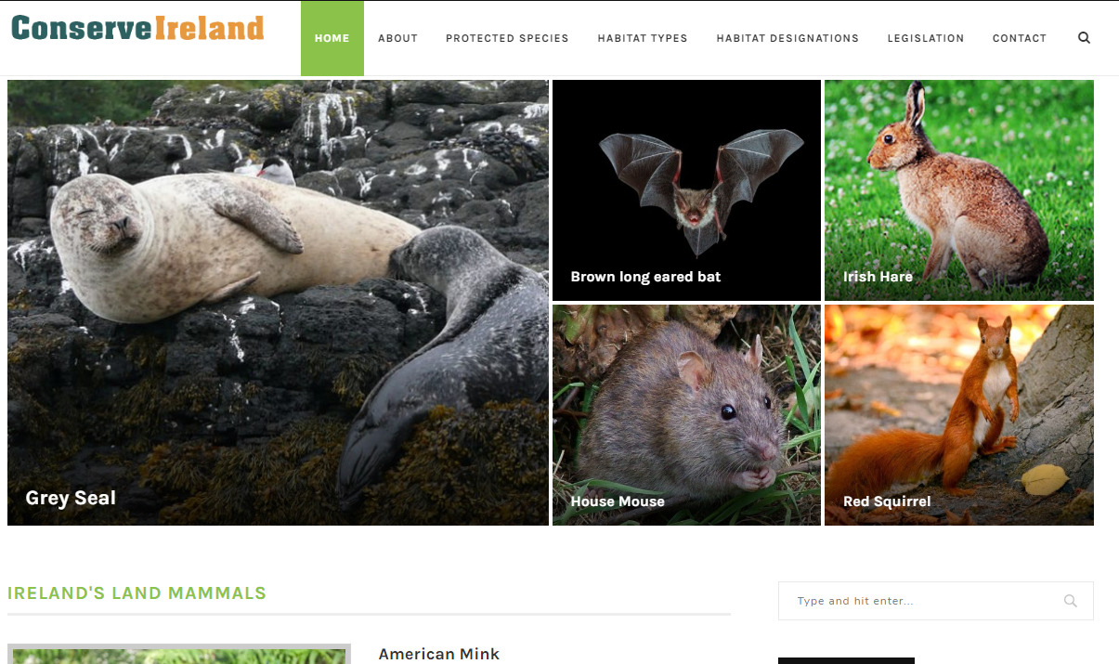
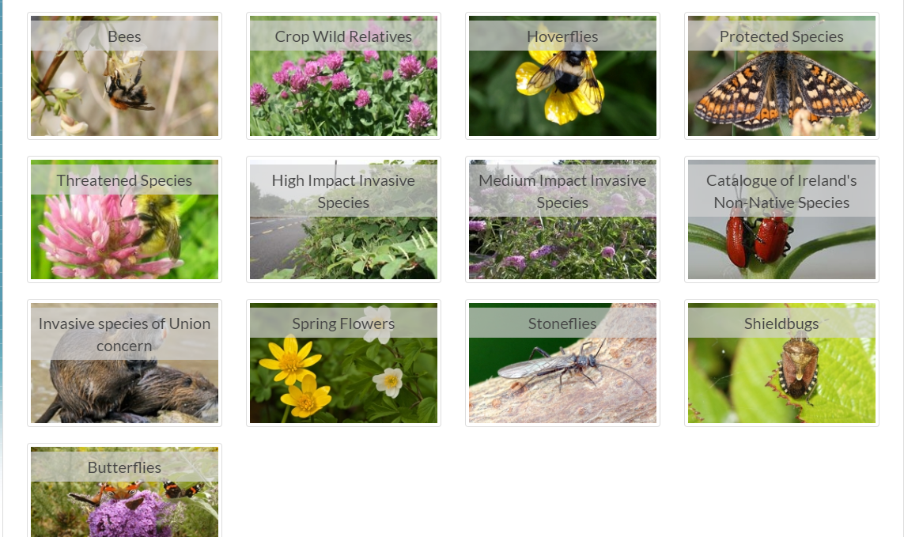
Wildlife & Habitat Protection
http://www.conserveireland.com/ - info on protected & endangered species-mammals, birds, fish, insects, habitat types in Ireland, habitat designations
Invasive species – Non-native species - Endangered Species – National Biodiversity Data Centre - https://species.biodiversityireland.ie/
Wildlife Act 1976-2000 – Irish Protection Law for Wildlife, also European & International protection laws
Underpinning legislations for nature conservation and biodiversity in each country.
Particularly in relation to the protection of birds and their nests, bats as well as flora and the introduction of invasive species.
Hedgerow cutting – banned from April to August – bird nesting season
Any tree over 10 years old requires permission to be cut down.

Slide 22
11. Make a 3 Year Plan - Management Plan
Year 1
Season | Action | Purpose | Comments/Notes/Monitoring
Spring | Mark out pathways of FS site | To minimise ground compaction | Fix point photos – to monitor over time
Spring | Mark site of fire | To minimise ground compaction | Fix point photos – to monitor over time
Spring | Check tree safety | Site & children safety | Get tree expert in to assess trees
Summer | Survey flora of site | Baseline assessment of flora onsite | See list attached on separate doc
Summer | Survey fauna of site – bug hunts, signs of wildlife | Baseline assessment of fauna onsite | See list attached on separate doc
Autumn | Gather tree seeds from the FS site/Start tree nursery | To plant future trees/Education for kids/Sell on to raise money for materials | Can be mobile in boxes-don’t need fixed site
Winter | Make and install 4 bird boxes, habitat piles | Create additional habitats in FS site/educational | Research types of bird boxes/buy wood Recording sheet – observe and record successful broods/activity in nest boxes
Notes:
This is an example of what your 3 year management plan can look like…
There is a template in the myForest – which you can also use, but this is one that myself and Mark have devised.
We have outline activities for the 4 different seasons – spring-summer-autumn-winter
Action to carry out
What its purpose is
Any notes/comments

Slide 23
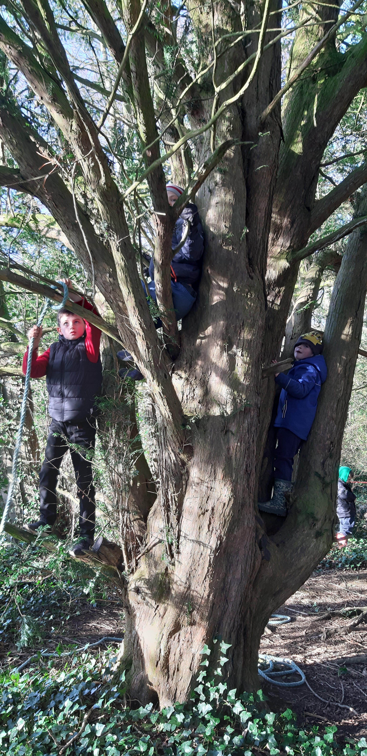
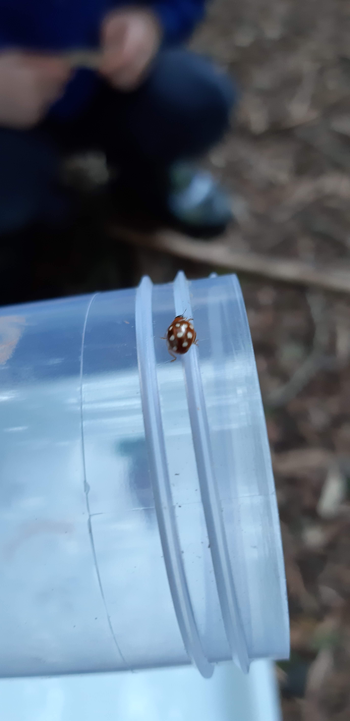
CH Forest School Site – through the seasons
12. MONITOR AND RECORD WHAT YOU ARE DOING - Keeping a log of the different species and what’s happening throughout the year, taking photos from fixed points can be really useful in terms of monitoring impact over time and at different times of year.

